Slide 1


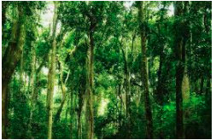
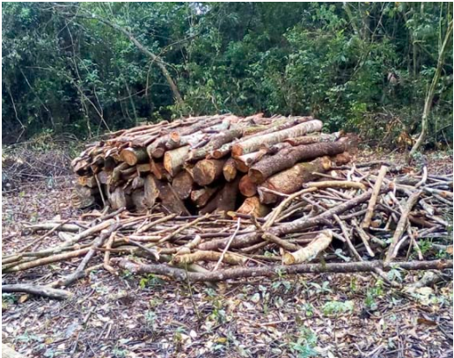
EfD-Mak-Centre, Uganda
Policy Dialogue with Kabale DLG
Forestry and Biodiversity: Addressing the Challenges of Forest Degradation and enhancing Environment Management in Uganda
Prof. Johnny Mugisha: Deputy Director, EfD-MAK Centre
3rd November, 2021

Slide 2
Overview
As natural features in the landscape, ecosystems provide environmental, social and economic benefits to communities.
Forests are ecosystems that represent almost 30% of terrestrial land cover worldwide (3, 999 million ha), containing 80% of all terrestrial biomass
They provide extensive benefits from a variety of ecosystem services.

Slide 3
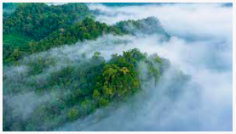
Why Forestry is Relevant
Function as major stores of atmospheric carbon, contributing to the regulation of climate change.
  Global forest resources with an average storage capacity of 73 tonnes per ha store approximately 292 billion tonnes of carbon
  The storage capacity of primary forests (24% of total) is in the order of 250 tonnes/ha, which is 82% of forest carbon worldwide.

Slide 4

Why Forestry is Relevant …
They sequestrate atmospheric carbon.
  Sequestration rate is estimated at 2.4 billion tonnes of carbon per year
  This makes them extremely important natural ecosystems in terms of climate regulation.

Slide 5
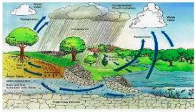
Why Forestry is Relevant …
Forests regulate water quantity, mitigating the effects of high flows in wet periods and low flows in the dry periods.
  Increased infiltration regenerates local aquifers and surface streams are maintained providing water resources in drier periods.
  Through these processes water quality is increased as it moves through these systems

Slide 6
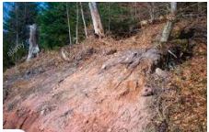

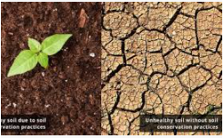
Why Forestry is Relevant…
Forests contribute to soil and water protection and biodiversity conservation through:
  Soil stabilization including reduction of soil erosion, maintenance of soil organic matter, increasing water infiltration and storage.
  Water supply protection through filtering water pollutants and regulating water yield and flow, enhancing precipitation and moderating floods, reducing surface erosion hence soil nutrient protection, protection against sedimentation and trapping of aerial pollutants.

Slide 7
Role of Forests in Uganda
Sustainably managed forests give environmental benefits, sustainable economic development and improve the quality of life of people across the country.

Slide 8
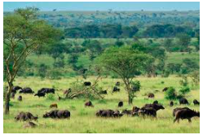
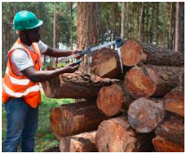
Role of Forests in Uganda…
Forests provide habitats for many native flora and fauna species, renewable products and energy and contribute to the development of a green economy.
Forests also provide a wide range of wood and non-wood products, clean water resources, and play a vital role in the mitigation of climate change.

Slide 9
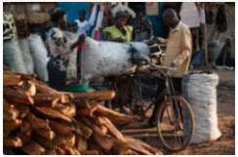
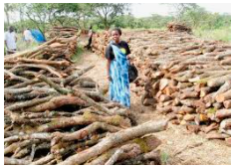
Role of Forests in Uganda…
Forests supply well over 90% of Uganda’s energy requirements in the form of fuelwood.
  Firewood and charcoal are important sources of energy not only to households (both rural and urban), but also for a majority of institutions and commercial establishments
  UBOS (2008) estimated that the total annual consumption of firewood was about 20 million tonnes (32.8 million cubic meters) of woody biomass.
  Although government and CSOs are promoting energy efficient technologies, such interventions are still insignificant, and hence have not had much effect on reducing the trend of consumption of wood based energy.

Slide 10
Governance and Forestry Sector Reforms in Uganda
The Uganda forestry sector reforms (1998 – 2003) aimed at providing more efficient and effective forest administration, management and utilisation of Uganda’s forest resources, through:
  The Forestry Policy (2001),
  The National Forestry Plan (2002),
  The NFTPA (2003) and
  A new institutional framework for the management of forestry resources in the country.

Slide 11
Governance and Forestry Sector Reforms in Uganda
It resulted in the birth of institutions such as:
  The NFA, the UWA, the DFS, private forest owners (PFOs), and community forests owners (CFOs).
Likewise, the reforms distributed responsibilities between the central government, LG agencies, the private sector, NGOs, community based organisations (CBOs), and the local communities.
The reforms aimed at promoting multi-stakeholder participation and promote transparency, integrity and professionalism in management of the forestry sector.

Slide 12
Governance and Forestry Sector Reforms in Uganda
Despite these good intentions, the forest estate in Uganda has continued to shrink from 4.9 million hectares in 1990 to currently 2.3 million hectares, NFA (2015) a loss of over half of the forests in a span of 25 years.
The reasons for this decline are mostly attributed to poor forest governance, and particularly problems with forest law enforcement and governance, and associated institutional issues.

Slide 13
Forestry and Forest Cover Changes in Uganda
According to the MWE report of 2015, forest estate has shrunk from 24% of the total land area in 1990 to 9% in 2015.
Out of this loss, about 2.2 million hectares were from the woodlands. It’s also true that the forest estate outside PAs reduced from 68% of the total forest land area in 1990 to 61% in 2005 and down to 38% in 2015.
This means that almost half of the unprotected forests have been cleared in just 25 years.

Slide 14
Forestry and Forest Cover Changes in Uganda
It is true that in a span of 25 years, Uganda has lost forests on 37% of the total land area despite the encouraging tree planting efforts by the both NFA and the private sector between 2005 and 2015.
The biggest loss of forest cover is from the privately owned category where 88% of well stacked Tropical High Forests (THFs), 80% of degraded THFs and 79% of woodlands were lost between 1990 and 2015.
Protected forests fared a bit better with only 2% of well stocked THFs lost over the same period and a growth of 20% in previously degraded THFs.
However, over this period, 46% of protected woodlands- mostly those under NFA, were lost.

Slide 15
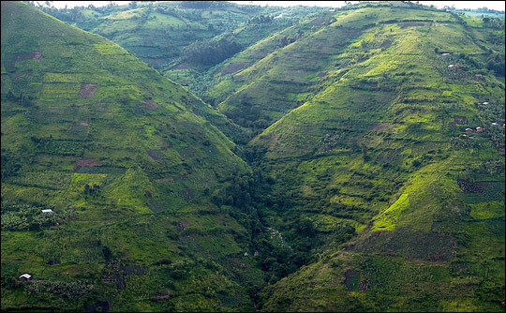
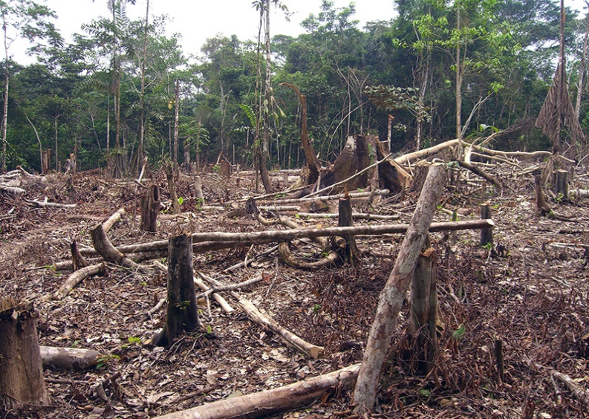
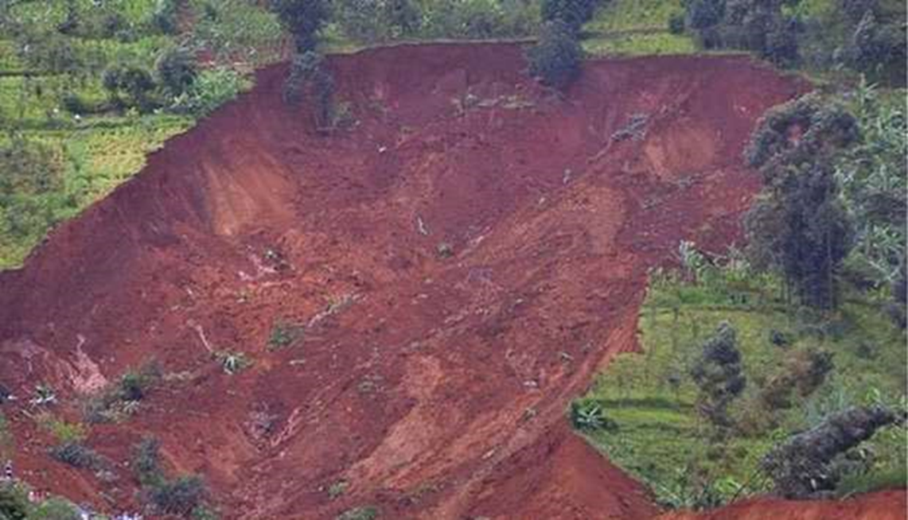
Forestry and Forest Cover Changes in Uganda
Degradation - decline in quality and loss of natural biodiversity. There is increasing land degradation (loss of fertility and declining agricultural productivity); land, water and air pollution, landslides

Slide 16
Forestry and Forest Cover Changes in Uganda
The rate of extraction (demand) increasingly exceeds the rate of replenishment (supply)

Slide 17
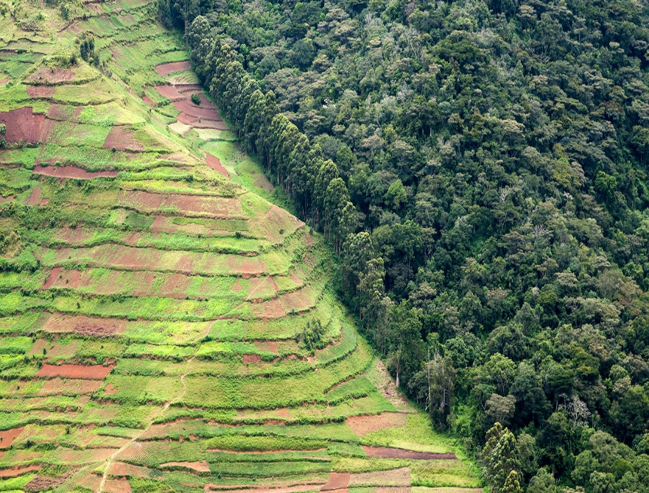
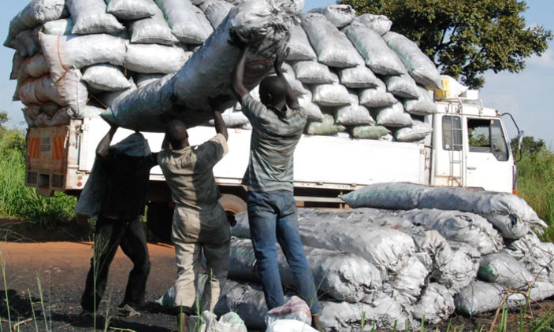
Major Drivers of Forest Cover Loss in Uganda
The main causes of deforestation have been mostly the conversion of forest land to other land use types such as agriculture and urbanization, and rampant felling of trees for firewood and charcoal burning.
The other important ones are issues relating to governance in the forestry sector, issues associated with illegal and unregulated trade of forest products and the unsecured forest tenure rights.

Slide 18
Governance crisis:
Poor governance has been blamed for the depletion of the ecosystem
Governance here can be defined as “the norms, institutions, and processes that determine how power and responsibilities over forests are exercised, how decisions are taken and how citizens – including women, men, youth, indigenous people and local communities – secure access to, participate in, and are impacted by the management of forests”

Slide 19
Policy Questions for Discussion
What are the key governance issues in the forestry sector?
How can communities be strengthened to participate in forest recovery programmes in Uganda?
What best forest restoration mechanisms should be adopted to revert the forest destruction trends?

Slide 20
Thank You
For your valuable
Attention

