Slide 1
FORESTRY & BIODIVERSITY LOSS: ADDRESSING THE CHALLENGES OF FOREST DEGRADATION AND ENHANCING ENVIRONMENTALMANAGEMENT IN UGANDA
Presented By: ARIYO BENJAMIN
FORESTRY OFFICER, KABALE

Slide 2
DEFINITIONS
A forest can be defined as land spanning more than 0.5 hectares with trees higher than 5 meters and a canopy cover of more than 10 percent.
Biodiversity is the biological variety and variability of life on Earth. It’s the variety of plant and Animal life in a particular Habitat
Biodiversity is the key measure of the health of any ecosystem and our entire planet

Slide 3
STATUS OF FORESTRY COVER IN KABALE DISTRICT
The district has a total area of 576 km2, out of which 116ha (1.16 km2) is plantation forest(eucalyptus and Pine)
Kabale plantations are a peri-urban forest for Timber, poles and firewood for the urban population
The district does not possess any Gazetted local forest reserves(apart from Kabale Central reserve comprising of Bugongi Block and Kigongi swampy Block all occupied by NFA)

Slide 4
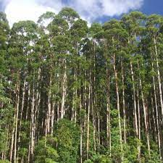
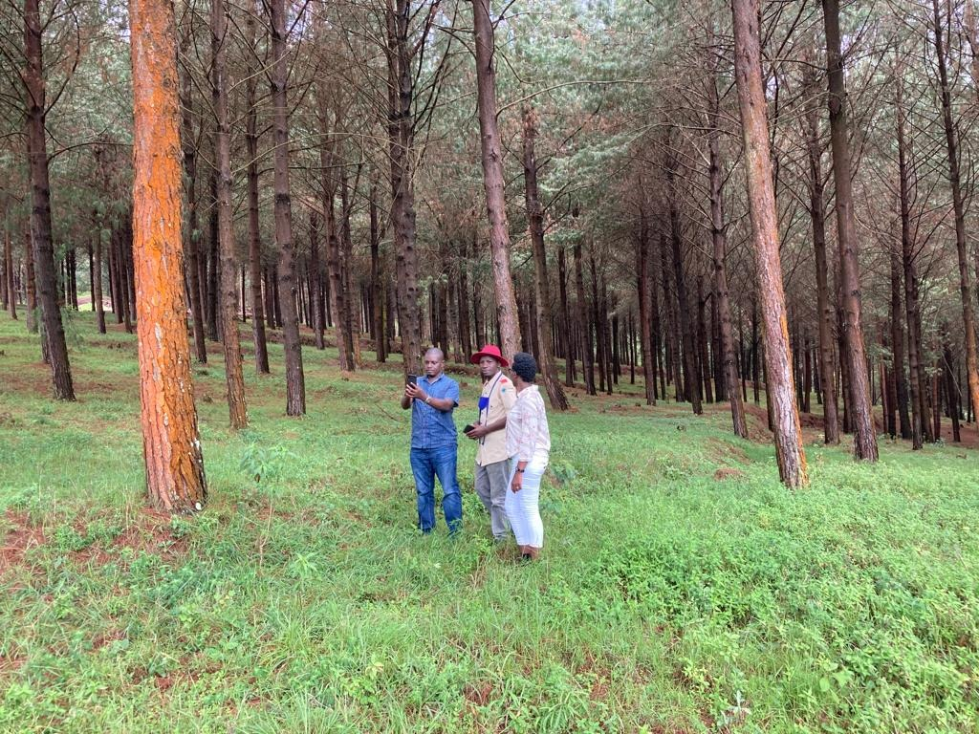
TREE SPECIES
Eucalyptus species
Pinus patula
Grevillea Robusta
Misopsis Emini
Cupressus Lusitanica
Black Wattle
Bamboo

Slide 5
BIODIVERSITY STATUS OF KABALE DISTRICT
Most forms of biodiversity is hosted in the wetland complexes with in the District
Lake Bunyonyi Complex hosts 130 species of birds
Major ones include Grey-Crowned Crane, Greater Swamp webler,
Amphibian species richness and Diversity, 265 individuals comprising of 21 amphibian species belonging to one order, Anura,7 families and Nine Genera have been recorded
Notes:
Handout : pg 185

Slide 6
All the amphibian species recorded are of the Least Concern both Globally and Nationally
Reptilian species richness and Diversity:
-36 individuals of two orders , Sauria and Serpentes, 5 families and 7 Genera
Note : All the 8 species of reptilian are Not Evaluated
Plant species Richness: 312 plant species belonging to 75 families have been recorded

Slide 7
Mammals:
21 species of mammals have been recorded
3 species of these are listed as Globally endangered, ie Terella Shrew, Montane Shaggy rat and Kahuzi Swamp shrew
Butterflies and Dragon Flies
A total of 37 species of butterflies and 19 species of dragon flies were recorded
6 species of butterfly species are nationally red-listed

Slide 8
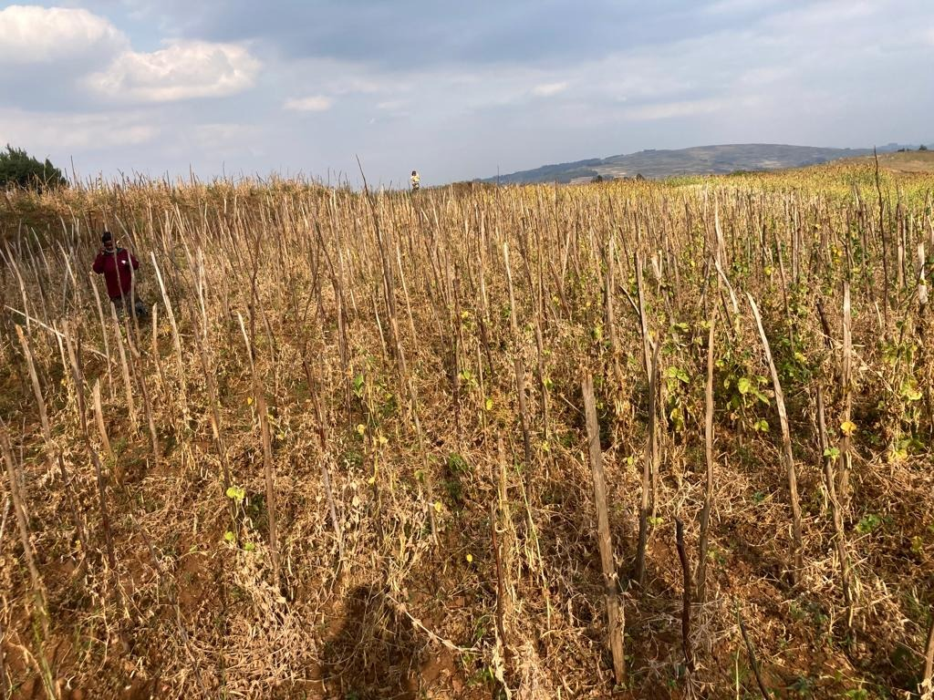
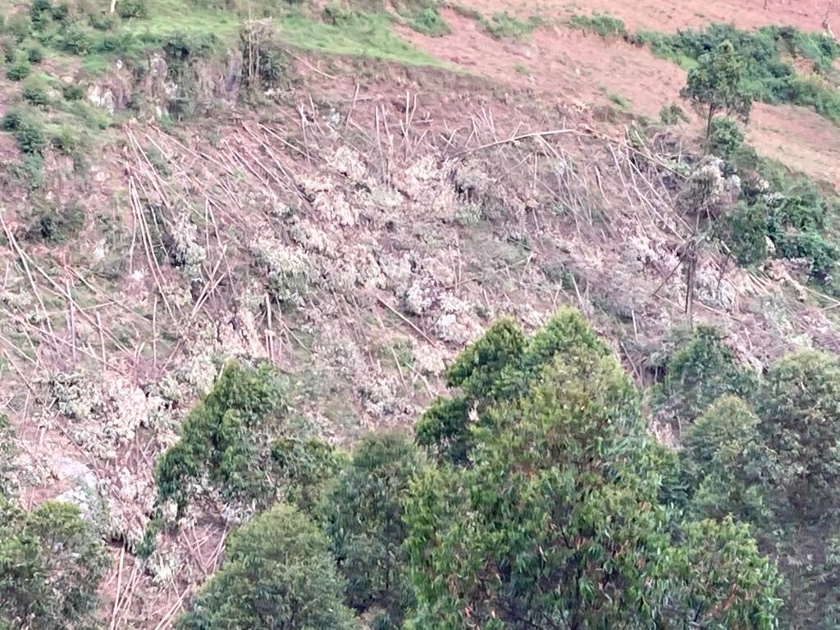
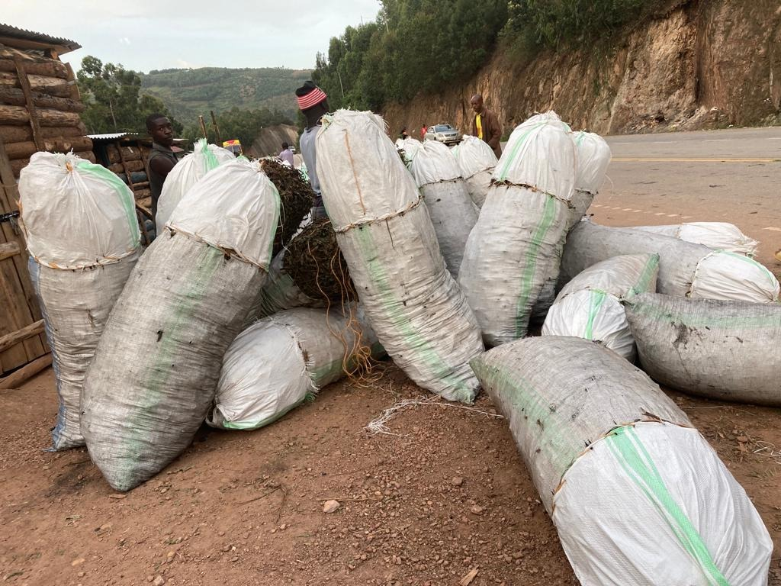
DRIVERS OF DEFORESTATION & BIODIVERSITY LOSS
High dependency on Forestry products
Un sustainable harvesting practices
Forest/ plantation fires
Infrastructure development
Invasive species
Climate change
Pollution
Human activities(Agriculture..ACDP)
Weak laws and policies

Slide 9
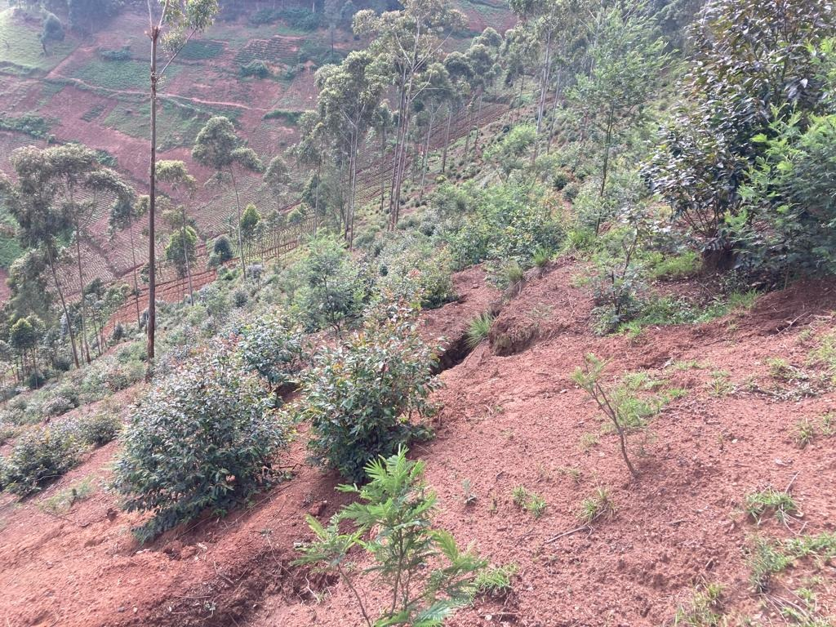
EFFECTS OF BIODIVERSITY AND FOREST COVER LOSS
Economic loss
Ecological effects
Social needs-Affects social life
Food insecurity
Disease out break

Slide 10
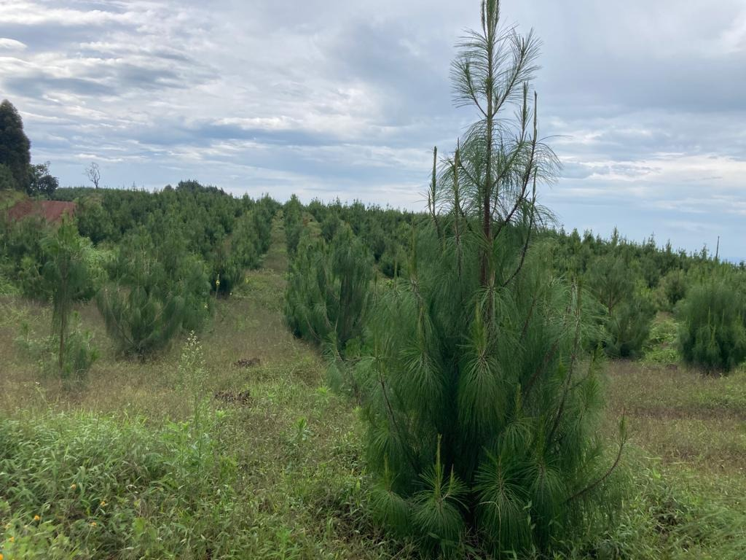
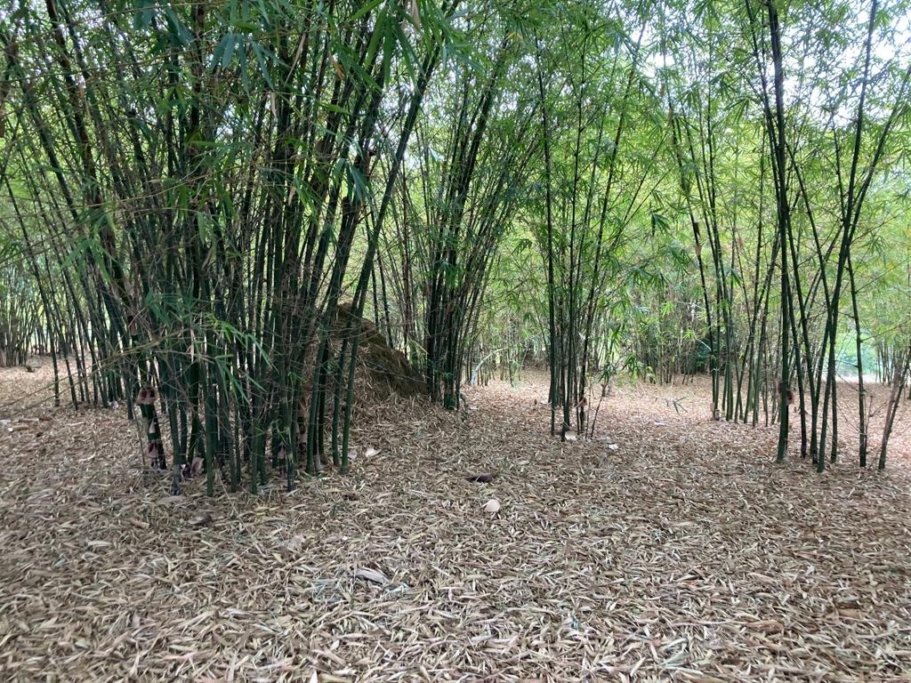
WAY FORWARD
Government restrictions and policies
Education
Protection of species
Habitat protection
Sustainable exploitation of resources
Control of invasive species
Use of eco-friendly products

Slide 11
CONCLUSION
Every kind of life that lives on Earth is vital for other living beings. Almost all living things are connected to support and maintain life cycles
THANK YOU, GOD BLESS YOU ALL!!!!!!!

