Slide 1
Patent filing and tips on patent drafting Makerere University – July 7, 2016
Kagwa John Marius – Examiner Patents

Slide 2
Presentation Overview
What is a Patent?
Patent system
Structure of patent application
Patent filing process

Slide 3
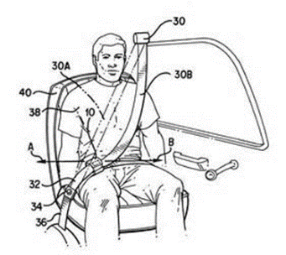
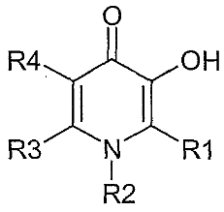
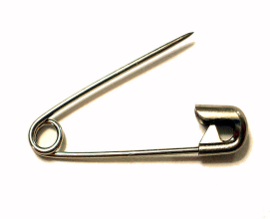
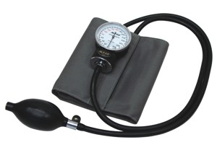
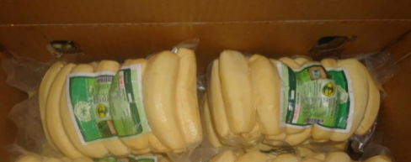
What is a Patent?
A patent is an exclusive right granted by the state for an invention which is a product or a process.
The product or process should provide in general, a new technical solution to a problem of any field.
The exclusive rights are territorial and patent protection is granted for a limited period, generally 20 years.
Dr. G.W. Byarugaba Bazirake patented a method of processing fresh vacuum sealed bananas (matooke)
A patent holder decides who may or may not exploit their protected invention.

Slide 4
The Patent System has two important functions:
1. Protection
A patent allows the patent holder to exclude others from commercially exploiting the invention covered by the patent in a certain country or region and for a specific period of time, generally not exceeding twenty (20) years.
2. Disclosure
A patent gives the public access to information regarding new technologies in order to stimulate innovation and contribute to economic growth.
There are about 80 million technologies that can be accessed in patent documents. These are technologies are in all fields, agriculture, electronics, pharmaceuticals, construction, energy e.t.c

Slide 5
Requirements for Patentability
Novel – Must be new, not anticipated by prior art (available information).
Inventive step (non- obvious) - Not easily deduced by a person with average knowledge of the technical field.
Industrially applicable - Invention must be useful/ have utility.
The subject matter must be accepted as patentable under the national patent law (Industrial Property Act, 2014).

Slide 6
Matters excluded from Patentability
A discovery, scientific theory or mathematical method is excluded from patentability, but its application or use can be patentable. An example, if you discover a new mineral or a new plant found in wild, it can not be patented. However if you identify a use/application, that will be patentable. Likewise Einstein could not patent his celebrated law E=mc².
Methods of doing business for example method of book keeping, trading stocks are not patentable

Slide 7
Matters excluded from Patentability – Cont’d
Diagnostic and surgical methods for the treatment of humans and animals.
Inventions contrary to public order, morality, public health and safety, principles of humanity and environmental conservation. Example, an invention that is a process for cloning human beings, inventions for making atomic weapons.

Slide 8
Rights of a Patent Holder
Decides who may or may not exploit the protected invention.
Permits/licenses others to use the invention on mutually agreed terms.
The inventor/patent holder can sell the invention.
These rights expire when the invention enters the public domain that is the public can now exploit the invention without authorization.

Slide 9
Patent Application
For one to obtain patent protection, a patent application must be filed with a patent office (URSB). The application has to be submitted with a request letter and proof of payment of application fees.
The application consists the following sections:
Title of the invention
Abstract –summary of the technical content of the patent document. Must be concise and precise
Description - Fully describes the invention and the manner in which it is to be performed.
Claims - defining the subject matter for which protection is sought. Give essence of what's new. Claims should be numbered.
Drawings where necessary

Slide 10
Tips on patent drafting
Unity of invention - The application should relate to one invention only or to a group of inventions so linked as to form a single general inventive concept.
The description should be fully detailed and clear to enable a person who has ordinary skills in the art to make use of and to evaluate the claimed invention.
Economic benefits should not be part of application, emphasis should be on technical effect of invention and how the invention works

Slide 11
Obtaining Patent protection
For one to obtain patent protection, a patent application must be filed with a patent office (URSB)
The application consists the following sections:
A title of the invention, abstract, background art, description, claims, drawings where necessary
Patent Application Procedure
Filing application formal examination prior art search & substantive examination grant/ publication
Rejection
Application fee – UGX. 180,000
Registration Fee – UGX. 300,000
There are three possible routes for filing a patent application. These are:
National route – Filing with URSB
Regional route for example filing with ARIPO
International route – filing a PCT application

Slide 12
END
Thank you
www.ursb.go.ug
Email: ip@ursb.go.ug
Face book: URSBHQ
Headquarters
Plot 5 George St. Georgian House
P.O Box 6848
Kampala

