Slide 1

BASIC NOTIONS OF INTELLECTUAL PROPERTY RIGHTS
Intellectual Property Training at Makerere University
A PAPER PRESENTED AT THE
07/07/2016

Slide 2
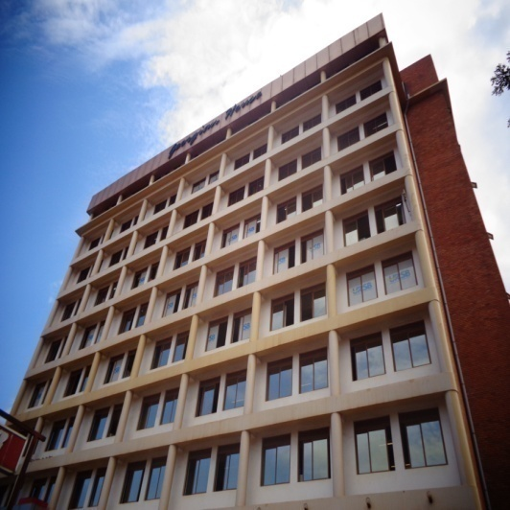
What is Intellectual Property(IP)/The concept of creativity and innovation

Slide 3
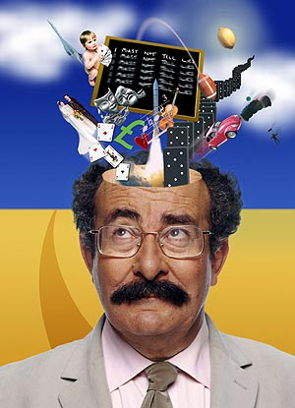

Slide 4
IP?
Intellectual property is property that originates from the mind(This statement is almost obvious because every bit of creation by man has began in the mind)
An idea is conceived and reduced to material form. Some ideas however might be reduced to intangible(unfeelable) forms.

Slide 5
IP?
Co-creation by man and animal began immediately God ended creation. since then, man has re-invented his environment through creation and discovery. This creativity starting with very humble and convenience origins escalated from 1760, and has now exploded into the phenomenon of industry innovation and creativity.

Slide 6
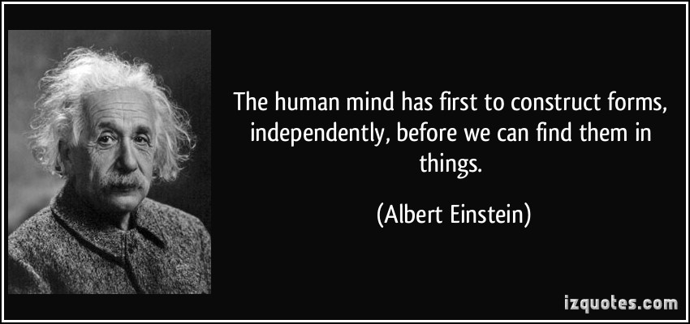
IP?
Today creativity and innovation are everywhere so that they have become part of daily life. Every day we use things made by man, but many times we forget that all the things we use in everyday life have a human mind and hand behind them.

Slide 7
What has man co-created/invented/improved

Slide 8
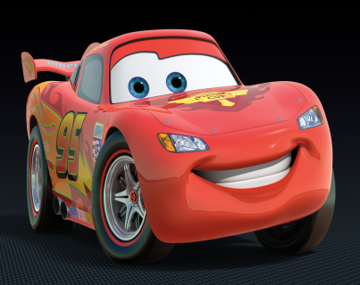
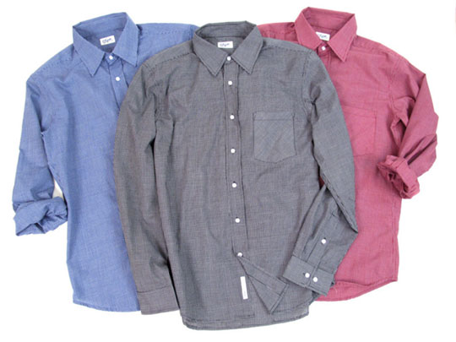
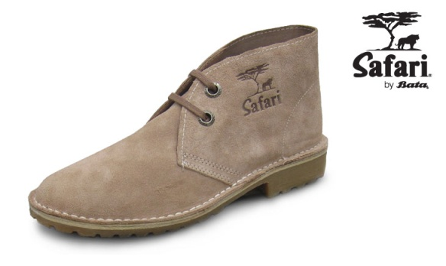


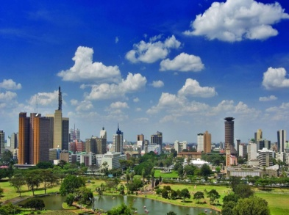



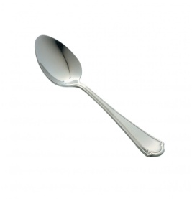


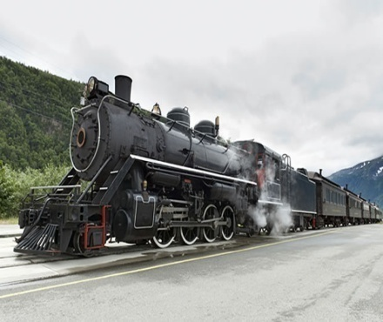
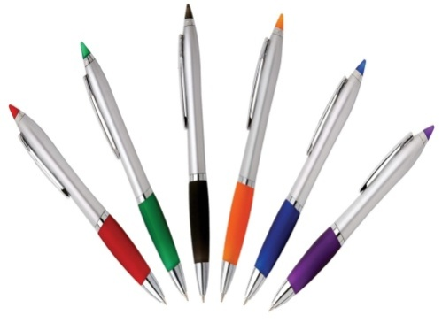
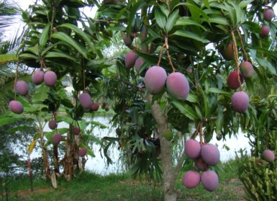
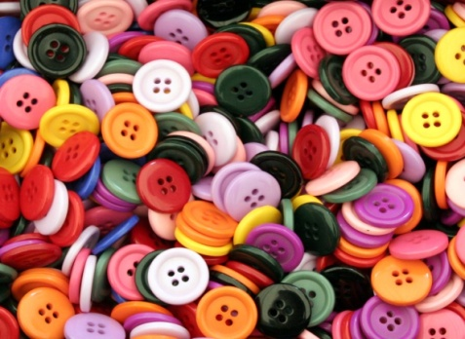
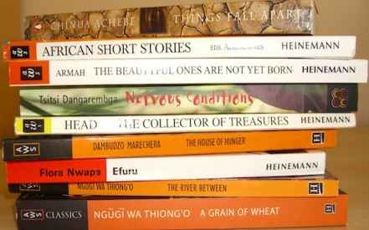
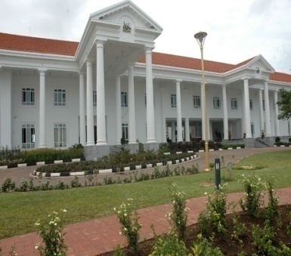
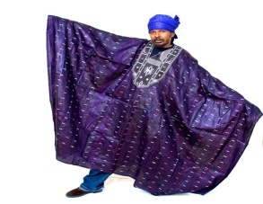
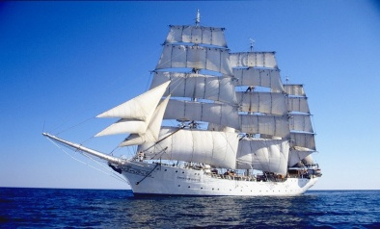

Slide 9
Co-creation
Everything seen in the previous slide is Intellectual Property itself. It has originated from the mind. It shows the transformation of human society and the result of creativity and innovation. It should then be observed that even the smallest item of artificiality(a bead, a thread)had a thinking mind behind it, a concept, a design before it came into being.

Slide 10

IP?
so is IP only about creation and invention?
IP goes further than just being creativity from the human mind, the concept of IP also requires that those who create, benefit! Let the minds that have gone into creativity and innovation get rewarded for it

Slide 11
IP?
Today, more and more, man is pushing for a benefit from his creation and innovation. It should also be known that since the co-creation of man, all his creation has been used by his fellow man in one way or the other sometimes giving off exploitation with no benefits. IP encourages Societies to,
CREATE! RECOGNISE! BENEFIT!

Slide 12
Types of IP
IP has various types due to the wide and far reaching inventions, innovations and creativity of man. All human creativity and innovation has a particular field of IP in which it falls. The following are among the most common fields of IP:
Trademarks/service marks
Patents
Designs
Geographical Indications
Traditional Knowledge and expression of folklore

Slide 13
Types of ip
Trademarks/Servicemarks
These are symbols and labels that identify and distinguish goods and services. They are on every product. The idea is that everyone is manufacturing that particular product or doing that particular service, so there is necessity to distinguish.

Slide 14

trademarks

Slide 15
trademarks
If a mark becomes so powerful to acquire global recognition, it becomes a brand e.g
Apple, DHL, Swatch, McDonald’s, Benz, Manchester United, Chelsea, Arsenal, Barcelona, Sony, Azam, Omo, Royco, Mukwano, House of Manji, House of Dawda, café Javas, Splash, Riham, EXE, Airtel, Safaricom, MTN, Uganda Waragi, Tusker, Nation, Bukedde, etc

Slide 16
Types of IP
Patents
Patents deal with coming up with something absolutely new that can be used in industry and manufacture. A patent has to be applied. You must be the first to event/come up with what you are claiming. e.g a spring and mobile chair/office chair, a retracting mirror, a paper punch, a box file, preservatives, shock absorbers etc

Slide 17
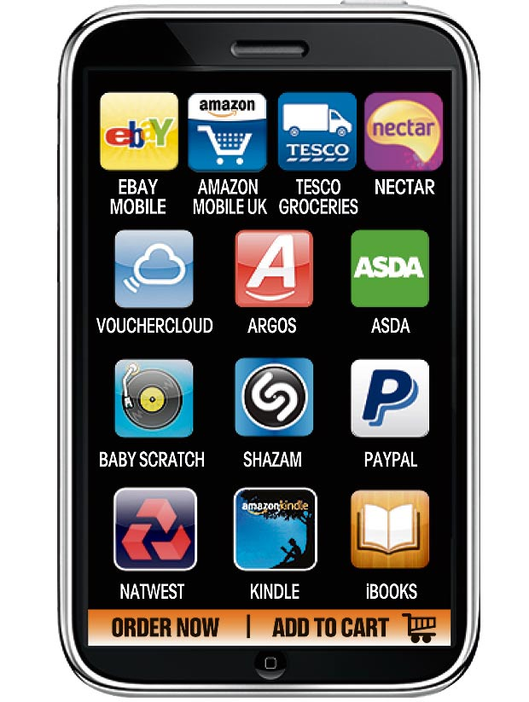
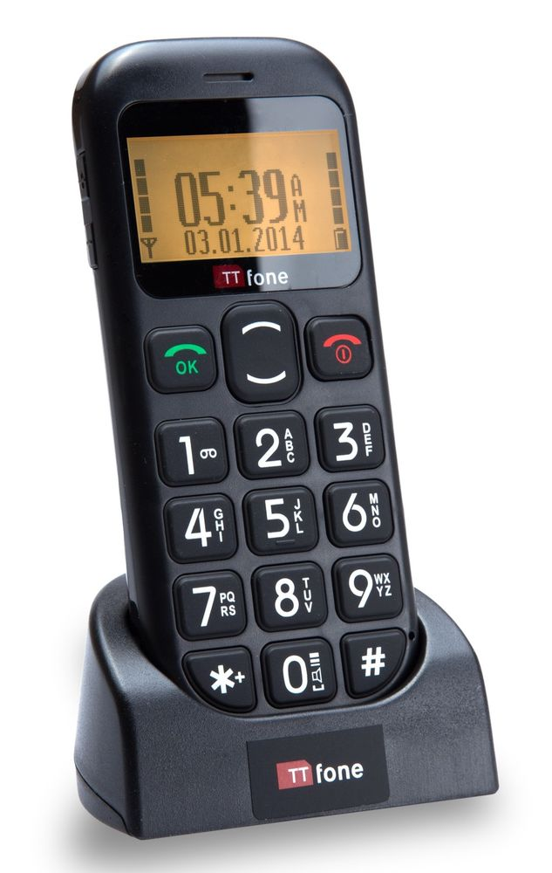
Patents

Slide 18
Types of IP
Designs
Design is the unique outer appearance of a product. Design more often than not is physical. Not only is design unique, it is also beautiful and attractive. Some designs have turned into trademarks for their products. Designs can be seen everywhere: bottles, shoes, clothing, cars, cups et al.

Slide 19
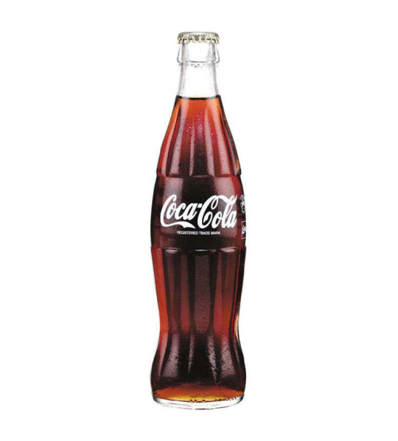
Designs

Slide 20
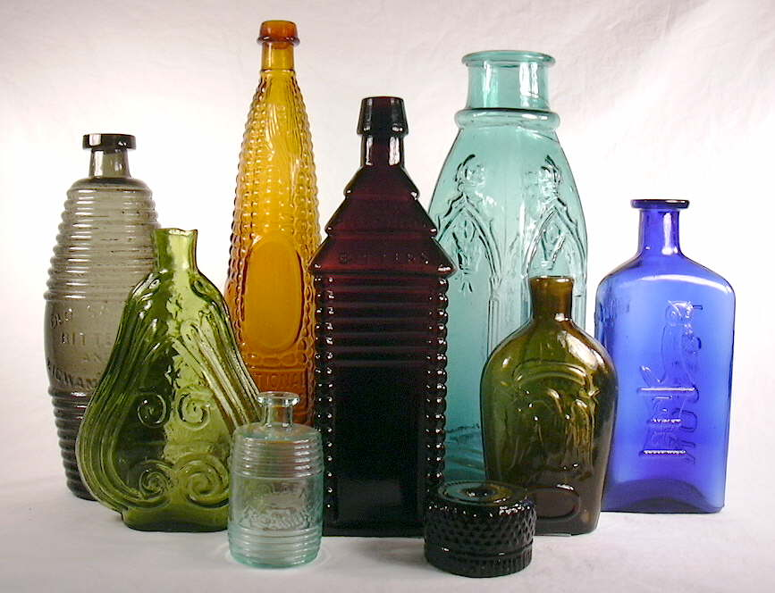

Designs

Slide 21
Types of IP
Geographical indications(GIs)
Geographical Indications(GI) is “Made in”:
Made in Kenya, Made in South Africa, Made in Italy, Made in GB, made in USA.
Countries have become brands and their names sale. A product made in a particular country will be yearned for more than the same product made in other countries.

Slide 22
GIs
To be more precise, sometimes GIs look at a particular product originating from a particular region of a country which confers upon it qualities not in other products of the same type.
Consider the crafts from Kenya and those from Uganda, electricals from UK/Japan, music from Congo/South Africa, Film from America(Hollywood), Watches from Switzerland, Leather from Italy, Football from Nigeria, cars from Germany, et al

Slide 23

GIs

Slide 24


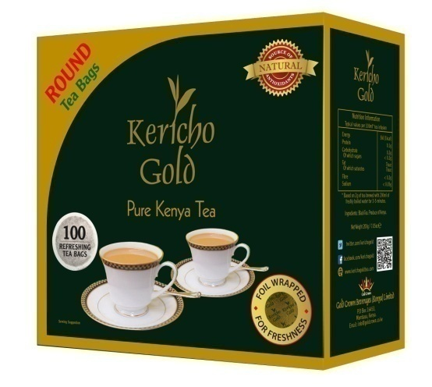

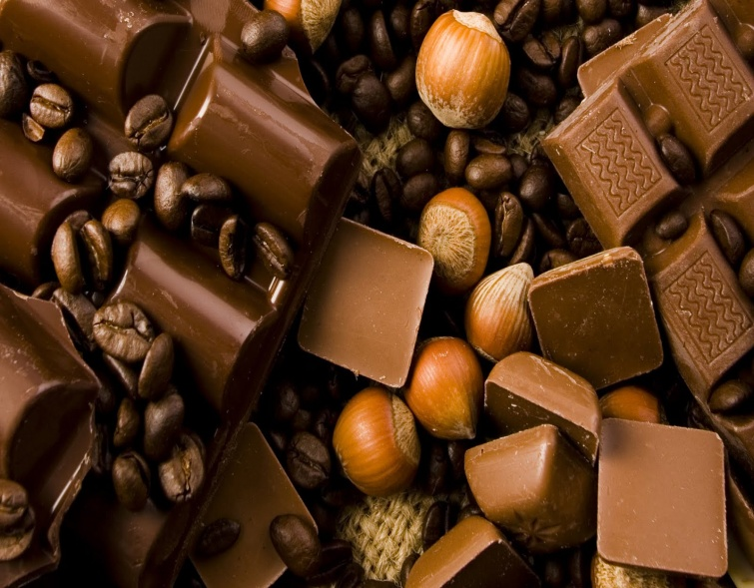
GIs

Slide 25
Types of IP
Copyrights
Copyright is about expression and making your expression different from what exists. Information in copyright is not original in itself but can be expressed differently from what is already in existence. e.g. songs, books, film, dance, architecture, designs, choreography, paintings, photography, engraving, Images(personal pictures)et al

Slide 26
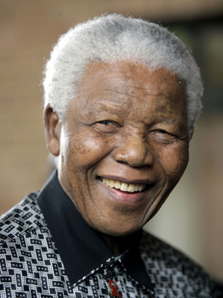
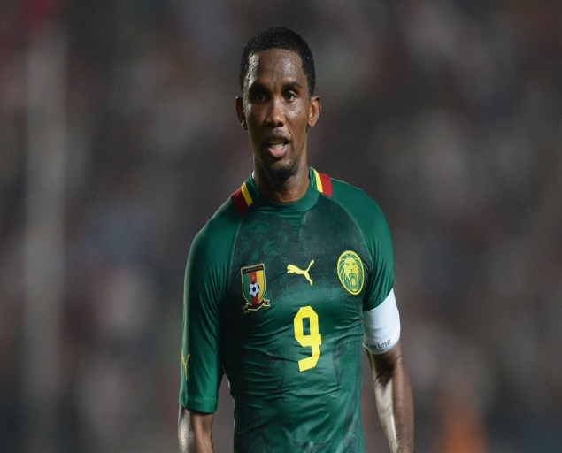

Copyright

Slide 27
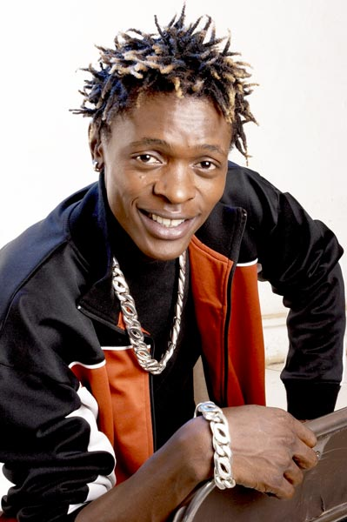

Copyright

Slide 28
Types of IP
Traditional Knowledge and expressions of folklore
These are expressions found in our traditional societies like song, dance, poetry, the way of doing things, medicines et al. Traditional knowledge also includes genetic resources that are unique to that area such as plants.

Slide 29
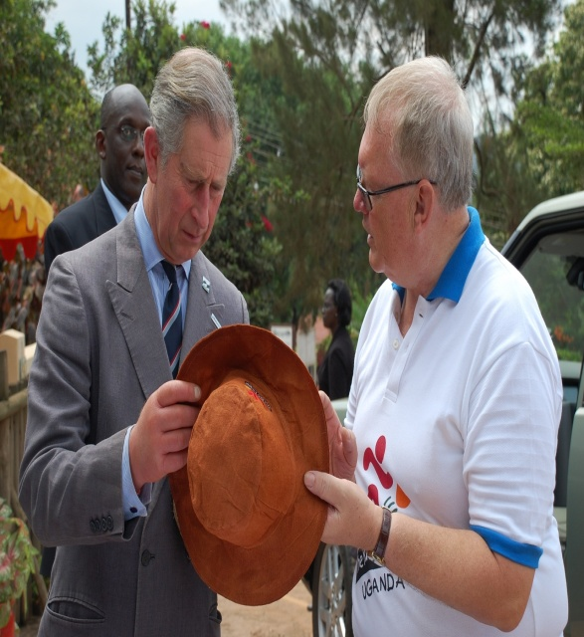
TK
Olubugo (barkcloth)

Slide 30
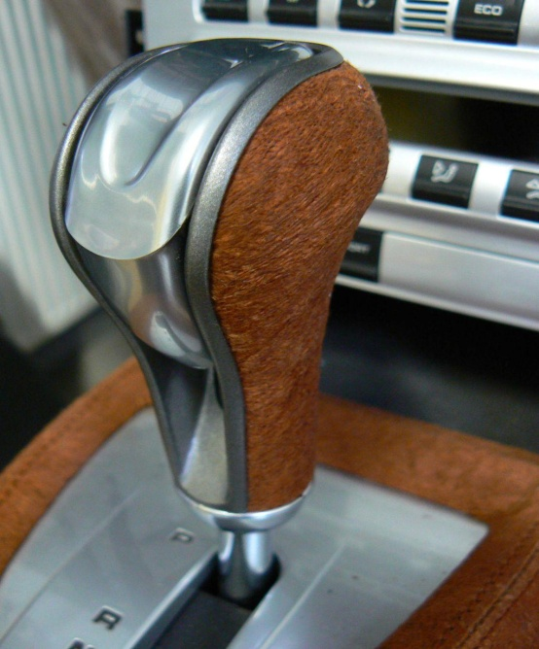
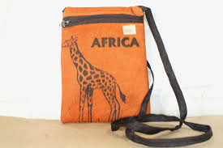
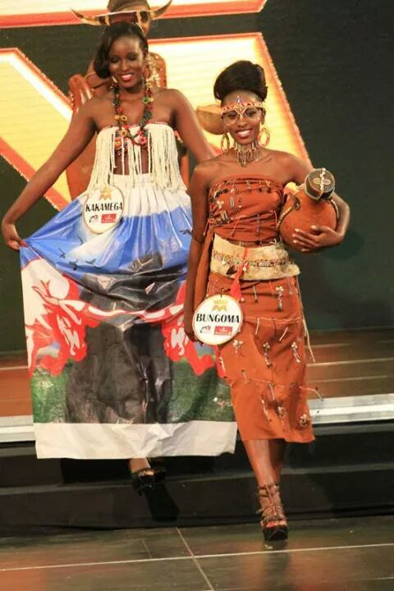
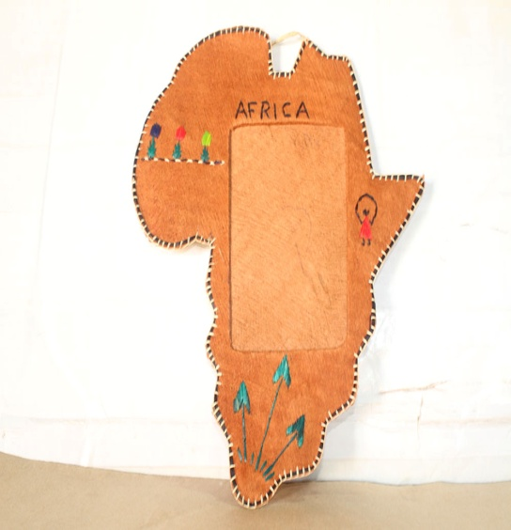
Olubugo

Slide 31
IP IN OUR ENVIRONMENT
Our environment is full of creativity, however almost all of it is still in the informal sector i.e with very little or no attention from Government and its Institutions(Parliament).
Without Government involvement, we shall not benefit much from the creative minds of our environment.

Slide 32
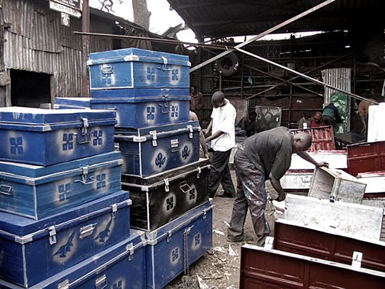
IP in our environment

Slide 33
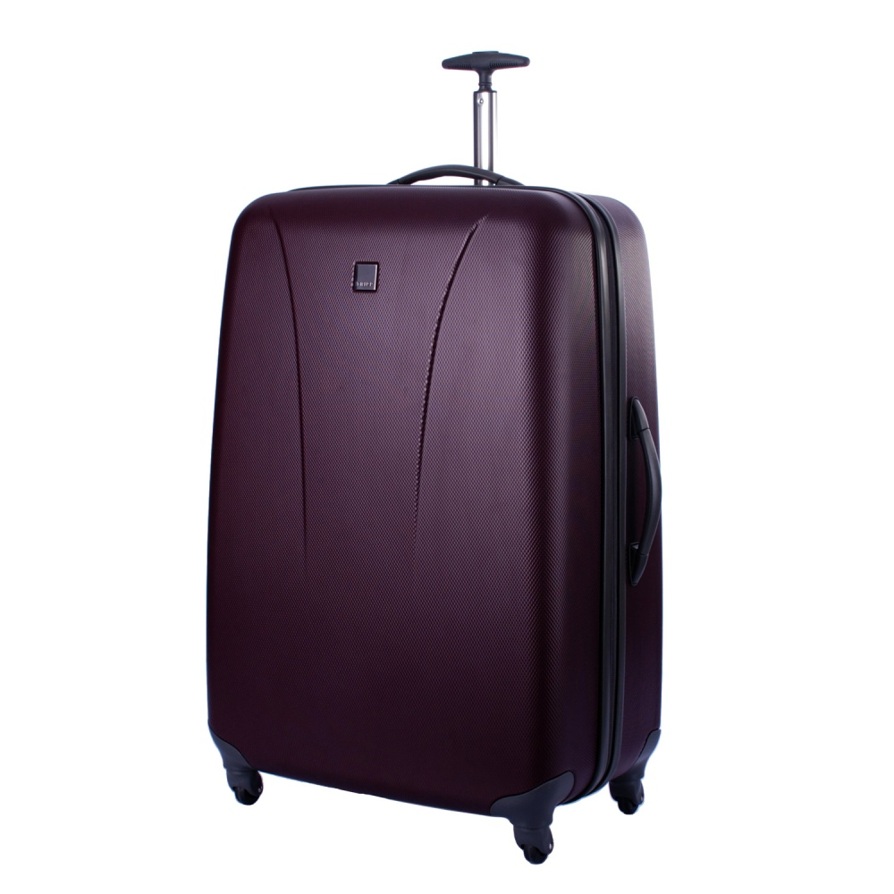
IP outside our environment

Slide 34

©Kalibbala Nyanja Phillip
Senior Registration Officer,
Intellectual Property
Uganda Registration
Services Bureau

