Slide 1



IPCC AR5 outreach event, Kampala, Uganda
Regional-scale climate change projections of annual, seasonal and monthly near-surface temperatures and rainfall in Uganda
Hannes Rautenbach
University of Pretoria
21 August 2014

Slide 2
Content
Major forces that modulate Earth’s climate system – heat as a driver for atmospheric flow;
Uganda climate within a global atmospheric circulation system;
Earth’s radiation budget and Representative Concentration Pathways for greenhouse gasses;
Modelling of the atmospheric system and experimental design of the regional dynamical downscaling simulations;
Future projections of near-surface temperature and rainfall in Uganda;
“Correcting” model results according to observations – regional statistical downscaling

Slide 3
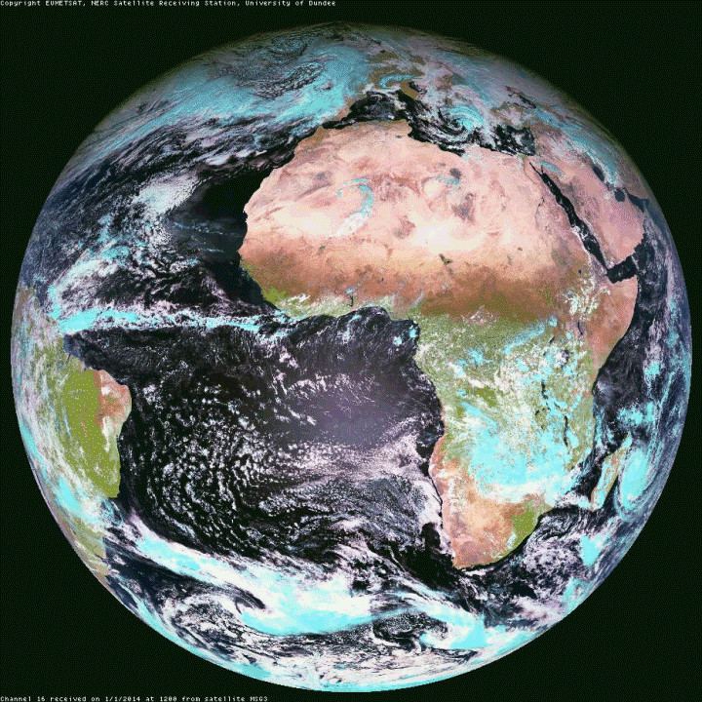
Satellite images:
January 2014, 12:00
The atmosphere behaves like a fluid with components of chaos in its propagation.
However, atmospheric mass (and therefore flow) is partially modulated by forces:
- Gravitation
- Temp & Pres gradients
Rotation
Friction and others
The influence of such forces results in some identifiable flow patterns or distinct rainfall zones
University of Dundee – Satellite Receiving
Station
www.sat.dundee.ac.za
Thank you
Thank you

Slide 4
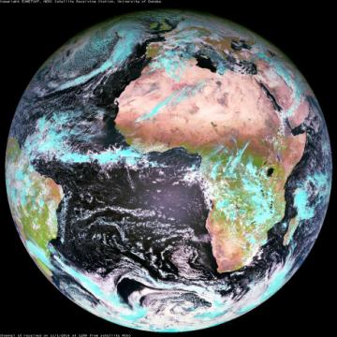
PLANETARY-SCALE atmospheric flow is considerably modulated by two drivers or forces:
Temperature gradients between the equator (higher T) towards the poles (lower T), as a result of surface HEAT radiation gradients. More heat radiation at the equator results in lower surface pressures which initiate surface flow from higher pressures regions (convergence). This leads to convection at the equator and subsidence at the poles (Hadley Circulation).
The rotation of the Earth, at one revolution in 24-hours, results in a surface velocity gradients from the equator (higher surface velocities) towards the poles (lower surface velocities).

Slide 5


PLANETARY-SCALE atmospheric flow is characterised by convection (lift of air mass) at equatorial regions (in reality above the HEAT equator) associated with easterly flow.
As a result, Uganda is located in an area of convection, with easterly surface flow (trade winds) which results in moisture advection from the Indian Ocean.

Slide 6
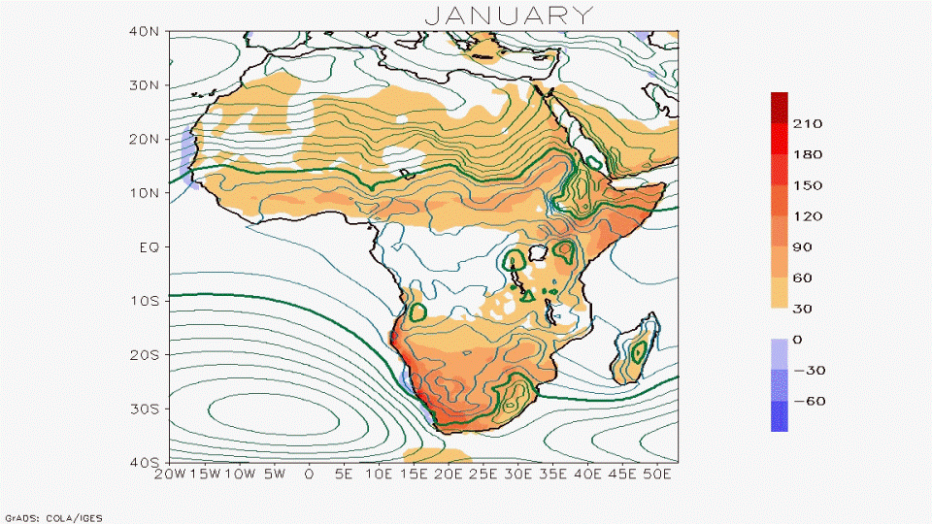
Continental HEAT (Sensible Heat Flux – shaded in W.m⁻²) has a noticeable influence on surface pressure patterns (Mean Sea Level Pressure – contours in hPa). Note how troughs develop during summer months over areas of high continental HEAT radiation.
ERA-Interim Reanalyses data: monthly sensible heat flux (W.m⁻²) and mean sea-level pressure (hPa) as calculated over the 20-year period 1986-2005.

Slide 7
Averaged (1986 to 2005) seasonal mean sea level pressure (hPa) and 850 hPa streamlines with specific humidity from ERA Interim Reanalysis data.

Slide 8
Averaged (1986 to 2005) seasonal mean sea level pressure (hPa) and 850 hPa streamlines with specific humidity from ERA Interim Reanalysis data.

Slide 9
DJF MAM
Estimated average (1981 to 2010) seasonal rainfall totals (mm.season⁻¹ ) as derived by the Global Precipitation Climatology Centre (GPCC).
JJA SON

Slide 10
DJF MAM
Averaged (1986 to 2005) seasonal near-surface
(2m above surface) temperatures (°C) as captured
by ERA Interim Reanalysis data.
JJA SON

Slide 11
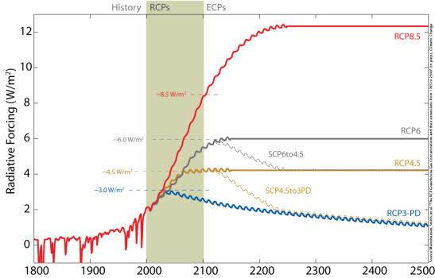
It is all about HEAT (W.m-2) = Energy
Global Anthropogenic Radiative Forcing for the high RCP8.5, the medium-high RCP6, the medium-low RCP4.5 and the low RCP3-PD.
In addition, two supplementary extensions are shown, connecting RCP6.0 levels to RCP4.5 levels by 2250 (SCP6TO45) or RCP45 levels to RCP3PD concentrations and forcings (SCP45to3PD).
± 950ppm
≈Doubling since IR
± 560ppm
± 370ppm
± 270ppm – beginning of industrial revolution (IR)
Reference:
Meinshausen, M., S. J. Smith, K. V. Calvin, J. S. Daniel, M. L. T. Kainuma, J.-F. Lamarque, K. Matsumoto, S. A. Montzka, S. C. B. Raper, K. Riahi, A. M. Thomson, G. J. M. Velders and D. van Vuuren (2011). "The RCP Greenhouse Gas Concentrations and their Extension from 1765 to 2300." Climatic Change (Special Issue), DOI: 10.1007/s10584-011-0156-z. http://www.pik-potsdam.de/~mmalte/rcps/

Slide 12

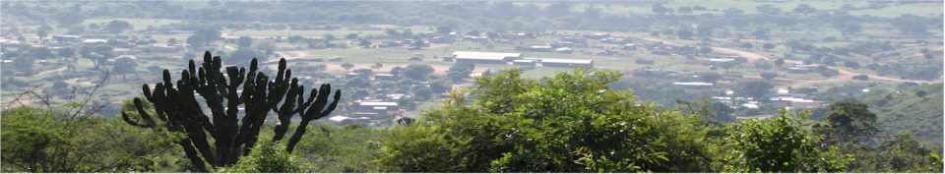

Modelling of the Atmosphere:
Conservation of momentum;
Conservation of mass;
Conservation of energy.
Models are computer
programmes developed
to “solve” the
atmospheric equations.
δz
$$\overline{F}=m\overline{a}=m\frac{∂\overline{U}}{∂t}=−2\overline{Ω}×\overline{U}−\frac{1}{ρ}\overline{∇}p+\overline{g}+\overline{F_{r}}$$
RAIN
δt
F = ma
Newton’s Second Law
physics
FLUXES
δy
δx
Z
y
X

Slide 13
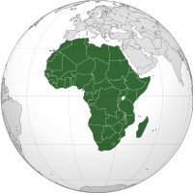
EXPERIMENTAL DESIGN
Results from an ensemble of four European based ocean-atmosphere Coupled Global Circulation Models (CGCMs),
which were accommodated with the IPCC AR5, were considered for generating historical and future climate projections.
HadGEM2-ES ocean-atmosphere CGCM
United Kingdom (UK) Hadley Centre (Caesar et al., 2013);
EC-EARTH ocean-atmosphere CGCM
EC-Earth consortium, coordinated by the Royal Netherlands Meteorological Institute (KNMI) (Hazeleger et al., 2012);
Dynamical downscaling: The four ocean-atmosphere CGCMs provided lateral boundary input to the COnsortium for Small-scale MOdeling-climate mode (COSMO) (version 4.8) model of the Climate Limited-area Modelling (CLM) community, known as the COSMO-CLM 4.8 or CCLM 4.8 Regional Climate Model.
COoRdinated Downscaling
EXperiment (CORDEX)
Grid resolution of
44º x 0.44º (≈50km x 50km).
CNRM-CM5 ocean-atmosphere CGCM
National Centre for Meteorological Research (CNRM), Climate Modelling and Global Change team, France - Meteo France
(Voldoire et al., 2011)
MPI-ESM-LR ocean-atmosphere CGCM
Max-Planck-Institut für Meteorologie
(Giorgetta et.al., 2013).

Slide 14
2 x 150-year simulations, each with a different CO₂ concentration pathway, were completed by each one of the four models.
20-year periods (historical, +50 and +80 years from present) of averaged temperature and rainfall were considered for analyses.
RCP 4.5
1986
2005
2046
2065
2075
2095
+ 50 years
+ 80 years
RCP 8.5
1986
2005
2046
2065
2075
2095
+ 50 years
+ 80 years

Slide 15
Projected change of the MEDIAN
RCP 4.5: Annual temperature change (ºC) relative to 1985-2005 RCP 4.5: Annual rainfall change (mm/month) relative to 1985-2005
2046 – 2065 (+50 years) | 2076 – 2095 (+80 years) | 2046 – 2065 (+50 years) | 2076 – 2095 (+80 years)
RCP 8.5: Annual temperature change (ºC) relative to 1985-2005 RCP 8.5: Annual rainfall change (mm/month) relative to 1985-2005
2046 – 2065 (+50 years) | 2076 – 2095 (+80 years) | 2046 – 2065 (+50 years) | 2076 – 2095 (+80 years)

Slide 16
Projected change of the MEDIAN – RCP4.5
Seasonal temperature change (ºC) for 2046 – 2065 (+50 years) - relative to 1985-2005
DJF | MAM | JJA | SON
Seasonal temperature change (ºC) for 2076 – 2095 (+80 years) - relative to 1985-2005
DJF | MAM | JJA | SON

Slide 17
Projected change of the MEDIAN – RCP4.5
Seasonal rainfall change (mm/month) for 2046 – 2065 (+50 years) - relative to 1985-2005
DJF | MAM | JJA | SON
Seasonal rainfall change (mm/month) for 2076 – 2095 (+80 years) - relative to 1985-2005
DJF | MAM | JJA | SON

Slide 18
Projected change of the MEDIAN – RCP8.5
Seasonal temperature change (ºC) for 2046 – 2065 (+50 years) - relative to 1985-2005
DJF | MAM | JJA | SON
Seasonal temperature change (ºC) for 2076 – 2095 (+80 years) - relative to 1985-2005
DJF | MAM | JJA | SON

Slide 19
Projected change of the MEDIAN – RCP8.5
Seasonal rainfall change (mm/month) for 2046 – 2065 (+50 years) - relative to 1985-2005
DJF | MAM | JJA | SON
Seasonal rainfall change (mm/month) for 2076 – 2095 (+80 years) - relative to 1985-2005
DJF | MAM | JJA | SON

Slide 20
Projected percentage (%) change
RCP 4.5: Annual rainfall change (mm/month) RCP 4.5: Annual rainfall change (mm/month)
2046 – 2065 (+50 years) | 2076 – 2095 (+80 years)
RCP 8.5: Annual rainfall change (mm/month) RCP 8.5: Annual rainfall change (mm/month)
2046 – 2065 (+50 years) | 2076 – 2095 (+80 years)

Slide 21
Projected percentage (%) change – RCP4.5
Seasonal rainfall change (mm/month) for 2046 – 2065 (+50 years) - relative to 1985-2005
DJF | MAM | JJA | SON
Seasonal rainfall change (mm/month) for 2076 – 2095 (+80 years) - relative to 1985-2005
DJF | MAM | JJA | SON

Slide 22
Projected percentage (%) change – RCP8.5
Seasonal rainfall change (mm/month) for 2046 – 2065 (+50 years) - relative to 1985-2005
DJF | MAM | JJA | SON
Seasonal rainfall change (mm/month) for 2076 – 2095 (+80 years) - relative to 1985-2005
DJF | MAM | JJA | SON

Slide 23
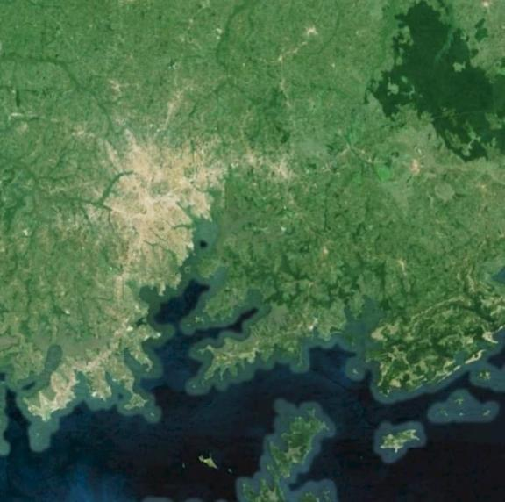
Dynamical and statistical downscaling for KAMPALA
The Kampala, Uganda domain (dashed square: 32.56ºE – 33.00ºE ; 0.0ºN – 0.44ºN) with the position of the four model grid points nearest to the metro pole. The average of rainfall and near-surface temperature values at these grid points were regarded as representative for Kampala, from where STATISTICAL DOWNSCALING
will be performed.

Slide 24
Dynamical and statistical downscaling for KAMPALA
Kampala (Uganda) annual rainfall totals (mm) for the moderate RCP 8.5 greenhouse gas concentration pathway as simulated over the historical period 1951 to 2005, and projected for the period 2006 to 2099 by the CCLM 4.8 Regional Climate Model (RCM) forced across its lateral boundaries by the 1) CNRM-CM5(red thin line), 2) HadGEM2-ES (thin blue line), 3) EC-EARTH (orange thin line) and 4) MPI-ESM-LR. The ensemble mean between these CGCMs are indicated by thick blue lines, and the linear trend in the ensemble projection is indicated by a thick dashed line.

Slide 25
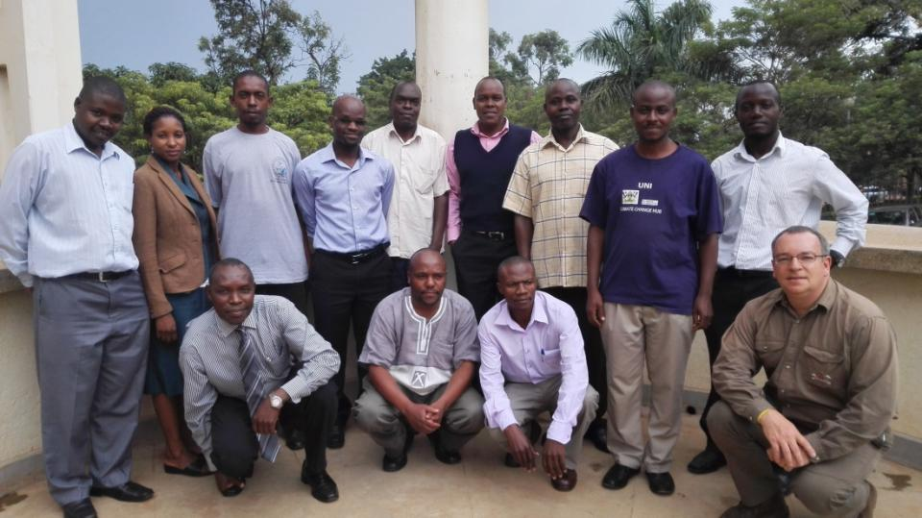
Development and Knowledge sharing workshop:
Makerere University, 18 – 20 August 2014
Delegates who attended the Climate Change Development and Knowledge sharing workshop that took place earlier this week at Makerere University

Slide 26
Thank you
hannes.rautenbach@up.ac.za
+27-12-420-2173
+27-82-480-6579
www.up.ac.za/waterup

