Slide 1
MUCCRI: MAK Centre for Climate Change
Research and Innovations
USAID/Uganda Education and Research to Improve Climate Change Adaptation Activity
Lynne M Carter, PhD, Chief of Party
Mfitumukiza David, Climate Adaptation specialist

Slide 2
Makerere University Centre for Climate Change Research and Innovations (MUCCRI)
Launched in 2013 motivated by the need to:
  Strengthen climate change research, innovations and information dissemination
Initiated through Rockefeller Funding to CAES
  “Strengthening East African Resilience and Climate Change Adaptation Capacity through Training, Research and Policy Interventions”
    Initiated the institutionalization process of MUCCRI
    Initiated review of curricula at CAES to include climate science and climate change issues
    Undertook research on climate change
In Final Stages of Makerere University Institutionalization

Slide 3
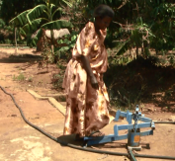
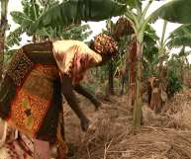
MUCCRI
Structured to work in 4 thematic areas:
  Climate Science
  Mitigation
  Adaptation
  Policy, Training and Outreach

Slide 4
Research During MUCCRI Start-up
Climate change adaptation and resilience among small holder farmers
Adapting to climate change in Uganda’s agricultural production and natural resources management systems
Improving integrated production and pest management of rice for climate change adaptations in Uganda
Screening of forages for drought tolerance and reseeding ability for feed and adaptation to climate change of dry-lands
Carbon sequestration of selected indigenous trees in Uganda’s rural landscapes

Slide 5





Partners
USAID/Uganda Education and Research to Improve Climate Change Adaptation Activity
FHI 360
Makerere University (MAK), College of Agricultural and Environmental Studies (CAES)
National Agricultural Research
Organization (NARO)
International Institute for Tropical Agriculture (IITA)
USAID/Uganda Feed the Future activities
Government of Uganda

Slide 6
Main Activity Goal
Assist Ugandans to build a hub of academic, professional development and research excellence in climate science, climate adaptation and related disciplines. With the hope that this hub will attract more research opportunities for MAK faculty from many disciplines and colleges and provide to Uganda the focus on climate information that will help the development of sustainable responses to a changing climate
This Activitiy is in partnership with Makerere University’s (MAK) College of Agricultural and Environmental Sciences (CAES) with goal of establishing and supporting of the Makerere University Centre for Climate Change Research and Innovations (MUCCCRI).
………….
While this effort builds upon a Rockefeller grant that was provided to CAES to support the start of establishing MUCCRI – the Centre will have a broader approach than just climate adaptation and capacity building – the focuses of this Activity – it will include: education, research, and policy considerations that address both adaptation and mitigation related issues.

Slide 7
Four Activity Result Areas
Support MUCCRI establishment
Build capacity through formal and informal education and training options
Generate high quality climate change and climate adaptation research
Disseminate research findings and other relevant climate change related information

Slide 8
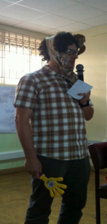
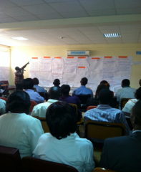
1. Support MUCCRI: Institutional structure of MUCCRI is established and supports MUCCRI objectives
Example Activities for Year One
Whole System in the Room Meeting and other partner networking efforts
Support official recognition of MUCCRI by the University
Encourage inclusion of MUCCRI in the CAES strategic plan
Set-up Adapt2CC platform /website – for MUCCRI

Slide 9
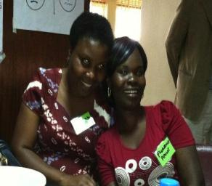
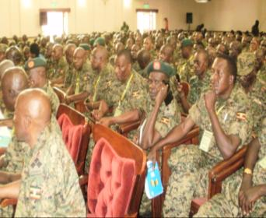
2. Build capacity: MUCCRI provides cutting edge short and long term training to students, staff, and external stakeholders
Example Activities Year One
Provide training and materials to Uganda media
Provide training to District Environment Officers, Army
Support the process of approval for the MSc in Climate Sciences
Identify and access on-line course offerings
Plan a monthly seminar series

Slide 10
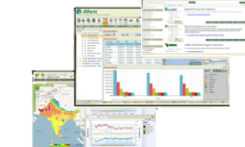
3. High quality research: MUCCRI is generating high quality climate change and climate change adaptation research
Example Year One Activities
  Cooperate with IITA/NARO
Support Student research scholarships
Integrate aWhere platform into
research outputs

Slide 11
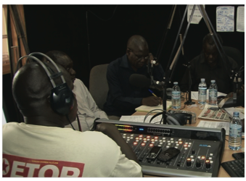
4. Disseminate research findings and other relevant information: MUCCRI is communicating with external stakeholders and disseminating climate change adaptation information
Examples of Year One Activities
  Work with partners to establish a dissemination pathway
    Research generators
    Community agents
    Extension
    Media

Slide 12
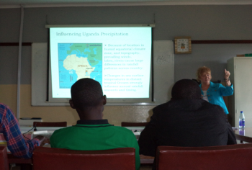
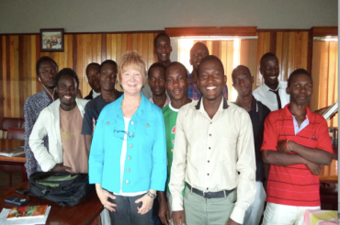
Cross-cutting activities: CLA, Gender, Youth
Collaboration, Learning , Adapting: revisions to planned activities – including research - through consultations – more important than its placement shows
Gender considerations: focused gender small projects to support some of the research efforts
Youth engagement: preparing Climate Change Association students to work with younger students; require all supported researchers to work with youth

Slide 13
Thank You
Contact Info
Lynne M Carter, PhD
lcarter@fhi360.org
David Mfitumukiza, PhD
dmfitumukiza@fhi360.org

