Slide 1
What does it mean for Uganda’s development?
Session title: Key Economic Sectors and services
Presenter, Prof Joseph Hella – Sokoine University of Agriculture – Tanzania – LA Chapter 10 AR5
Date: 21st August 2014

Slide 2
Economic Sectors & Services (ESS)
In Chapter 10 of IPCC AR5 meant to assesses the implications of climate change on
economic activity in key economic sectors and services,
economic welfare, and
economic development

Slide 3
What are these ESS
Energy
Water services
Transport
Other primary & Economic Activities
Recreation & Tourism
Insurance & Financial services
Health services
Market & Development
Other related

Slide 4
Key Drivers to Climate Change
Gradual changes in various climate attributes
(temperature, precipitation, windiness, cloudiness, etc.) and possible changes in the frequency and intensity of extreme weather events will progressively affect operation over time

Slide 5
Climate Change ……
will reduce ENERGY demand for heating and increase energy demand for cooling in the residential and commercial sectors (high agreement, robust evidence);
will affect different ENERGY sources and technologies differently, depending on the resources (water flow, wind, insulation), the technological processes (cooling) or the locations (coastal regions, floodplains) involved (high agreement, robust evidence).
may influence the integrity and reliability of PIPELINES & ELECTRICITY grids (medium agreement, medium evidence).

Slide 6
Climate Change ……
will have impacts, positive and negative and varying in scale and intensity, on WATER SUPPLY infrastructure and water demand (high agreement, robust evidence), but the economic implications are not well understood.
may negatively affect TRANSPORT infrastructure (high agreement, limited evidence).
will affect TOURISM RESORTS, particularly ski resorts, beach resorts, and nature resorts (high agreement, robust evidence) and tourists may spend their holidays at higher altitudes and latitudes (high agreement, medium evidence).

Slide 7
Climate Change ……
will affect INSURANCE SYSTEMS (high agreement, robust evidence).
will affect the HEALTH SECTOR (high agreement, medium evidence).
may decrease PRODUCTIVITY AND ECONOMIC GROWTH, but the magnitude of this effect is not well understood (high agreement, limited evidence).
Globally aggregated economic impacts of global warming are a small fraction of income up until 3°C [medium evidence, high agreement]..

Slide 8
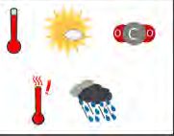
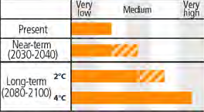
Key Risk – reduction in crop yield

Slide 9
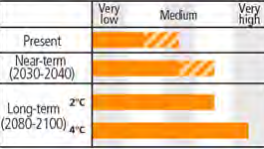
Key Risk – water supply

Slide 10
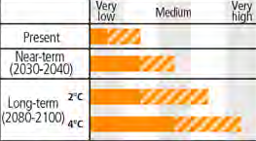
Key Risk - housing

Slide 11
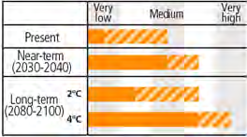
Key Risk – human displacement

Slide 12
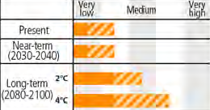
Key Risk - violent & conflicts

Slide 13
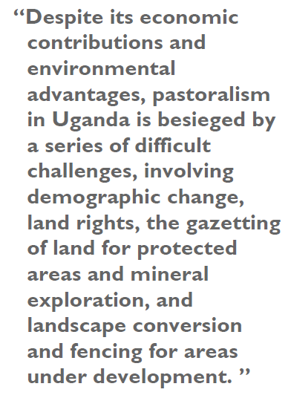
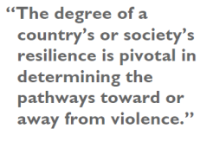
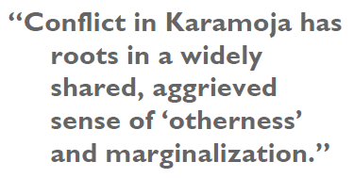
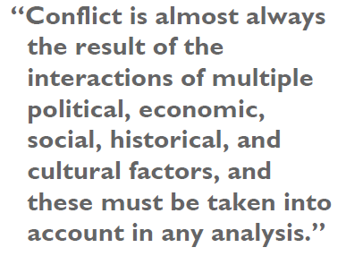
Source: USAID, 2010

Slide 14
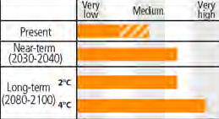
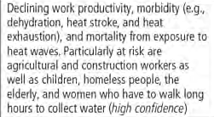
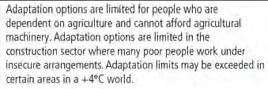
Key Risk– declining work productivity

Slide 15
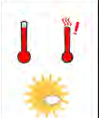
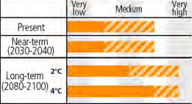
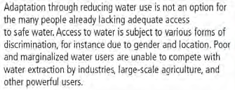
Key risk – Reduced access to water

Slide 16
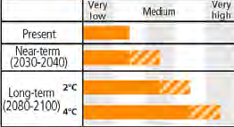
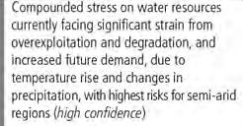
Key risk – Compounded stress

Slide 17
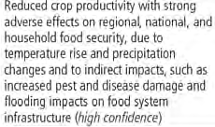
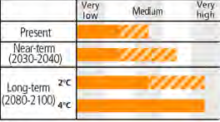
Key Risk – Reduced crop productivity

Slide 18
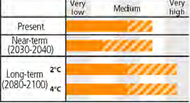
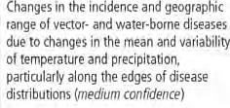
Key risk – Disease causing vectors

Slide 19
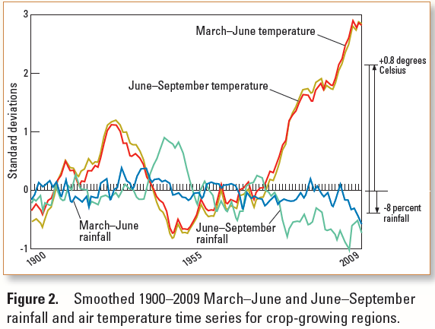

Slide 20
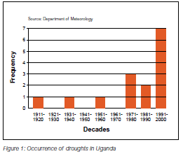
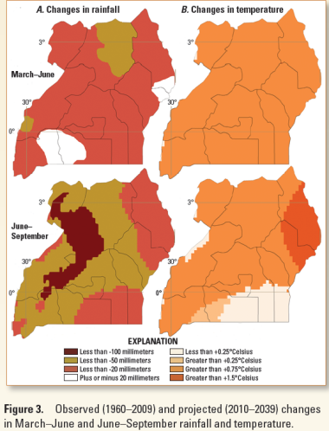
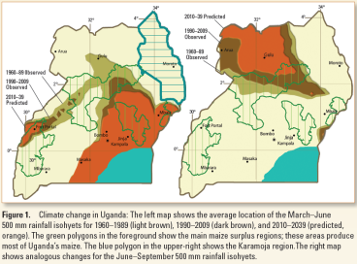
Situation in Africa - Ethiopia

Slide 21
Effects to Uganda Economy
Climate change is one of the greatest challenges affecting Uganda & already causing,
Food insecurity,
Landslides and soil erosion,
Water shortages and quality changes,
Energy insecurity,
Biodiversity loss,
Climate-related disasters,
Conflict due to resource scarcity and forced migration,
Disease pattern shifts.

Slide 22
What should be done
Vulnerability reduction through development and planning: Including many low-regrets options
Adaptation: Including incremental and transformational adjustments
Transformation
Mitigation

Slide 23
Options in totality
Human development options
Poverty reduction option
Engineered & built-environmental options
Technological options
Ecosystems based options
Services options
Laws & regulations options
Governance policies & programmes
Educational options
Behavioral options
Political options
Personal options

Slide 24
Options in totality ……..
Human development options
Education, nutrition, health facilities, social support, reduce gender inequality & marginalization
Poverty reduction option
Insurance schemes, social protection, disaster risk reduction, improve access & control of local resources, favourable land tenure
Livelihood security & Disaster management
Income & assets diversification, improved infrastructures, access to technology, access to decision making fora, enhance agency

Slide 25
Options in totality cont…..
Engineered & built-environmental options
Flood/cyclone shelters, water serving, assisted migration/translocation, ex-situ conservation, green infrastructures,
Spatial land use planning
Provision adequate houses, infrastructure & services, manage development high risk areas,
Ecosystems based options
Ecological restoration, reforestation, green infrastructures (trees, shades), contrroling over fishing, maintain seed banks

Slide 26
Options in totality cont….
Services options
Social safety nets; food banks; municipal services; water sanitations; vaccination programmes; public health; emergency medical services
Laws & regulations options
Land zoning, building standards, water regulations & agreements, laws to support disaster & risk mgt, law to encourage insurances plans, with defined property right & land tenure security, patent tools & technology transfer

Slide 27
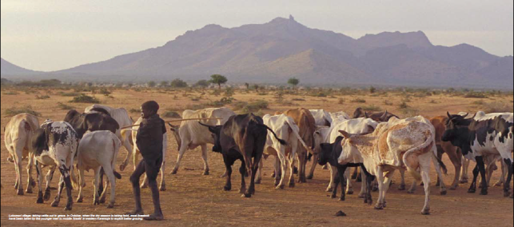
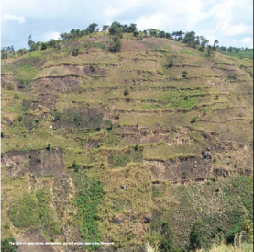
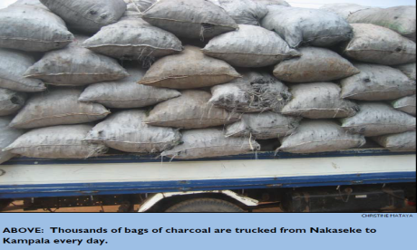

Slide 28
Options in totality …………..
Governance policies & programmes
National, regional, county & village plans; urban up-grading plans; municipal water mgt plans; disaster planning & awareness; integrated water resource mgt; ecosystem based mgt; community based mgt
Educational options
Awareness raising & integrate with education; gender equality; extension services; sharing local & traditional knowledge; participatory action research

Slide 29
Options in totality cont….
Behavioral options
Household preparation & evacuation plans; migration; SWC, livelihood diversification; change cropping, livestock, aquaculture practices, social networks
Political options
Change system that contribute to risk & vulnerability; delay practical transformation
Personal options
Individual & collective assumption; beliefs, values that influence climate change reponses

Slide 30
Role of markets, climate change & adaptation
Well-functioning markets provide an additional mechanism for adaptation and thus tend to reduce negative impacts and increase positive ones for any specific sector or country
The impacts of climate on one sector of the economy of one country in turn affect other sectors and other countries though product and input markets. Markets increase overall welfare, but not necessarily welfare in every sector and country

Slide 31
Conclusion
Climate change interacts with other factors/sectors and amplify existing stress on livelihoods, which will add to the vulnerability of those working in economic sectors (e.g. agriculture), thus will multiply existing threats to food, health, transport, financial services, energy, and economic security for the wider population:
THE FUTURE DEPEND ON WHAT WE DO NOW

Slide 32
Thank you for listening

