Slide 1

KIIRA EV Project
The Vision -> KMC
Professor Sandy Stevens Tickodri-Togboa
Principal Investigator,
+256312517888
http://crtt.mak.ac.ug
http://facebook.com/c4rtt
crtt@crtt.mak.ac.ug

Slide 2
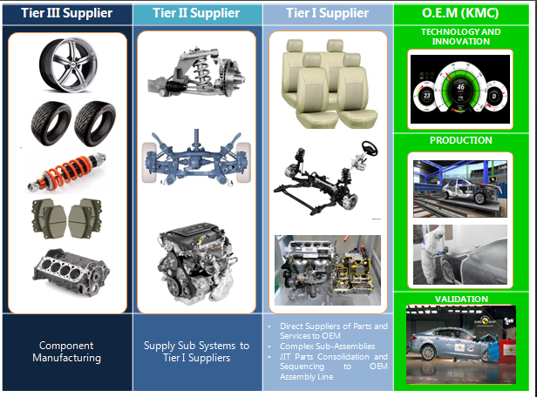

Slide 3
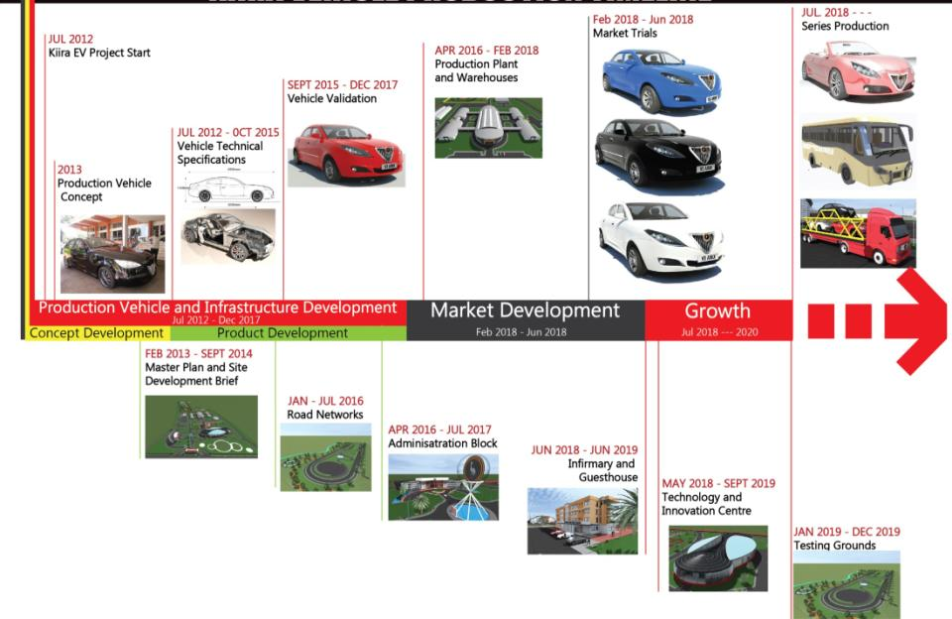
Kiira EV Project Timeline

Slide 4

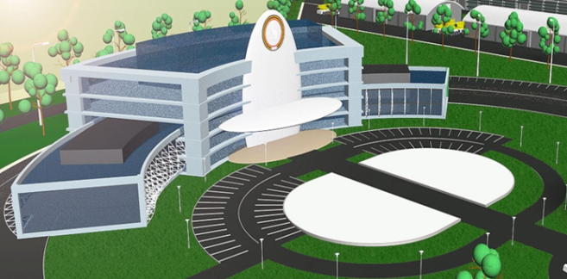
Employment >500 Professional Jobs
Economic Transformation -> HighTech Industrial Revolution
Revitalize Science Education
Value Proposition
KMC OEM

