Slide 1
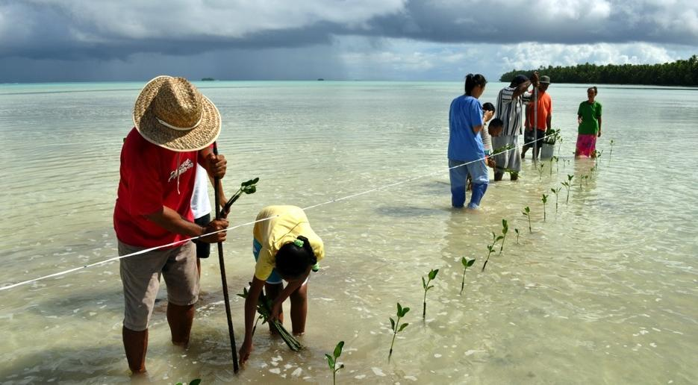
CLIMATE CHANGE 2014:
IMPACTS, ADAPTATION, AND VULNERABILITY
IPCC WGII
Katie Mach, Co-Director, Science

Slide 2




IMPACTS
CLIMATE
SOCIOECONOMIC
PROCESSES
Vulnerability
Natural
Variability
Socioeconomic
Pathways
Hazards
RISK
Adaptation and Mitigation Actions
Anthropogenic
Climate Change
Governance
Exposure
EMISSIONS
and Land-use Change

Slide 3
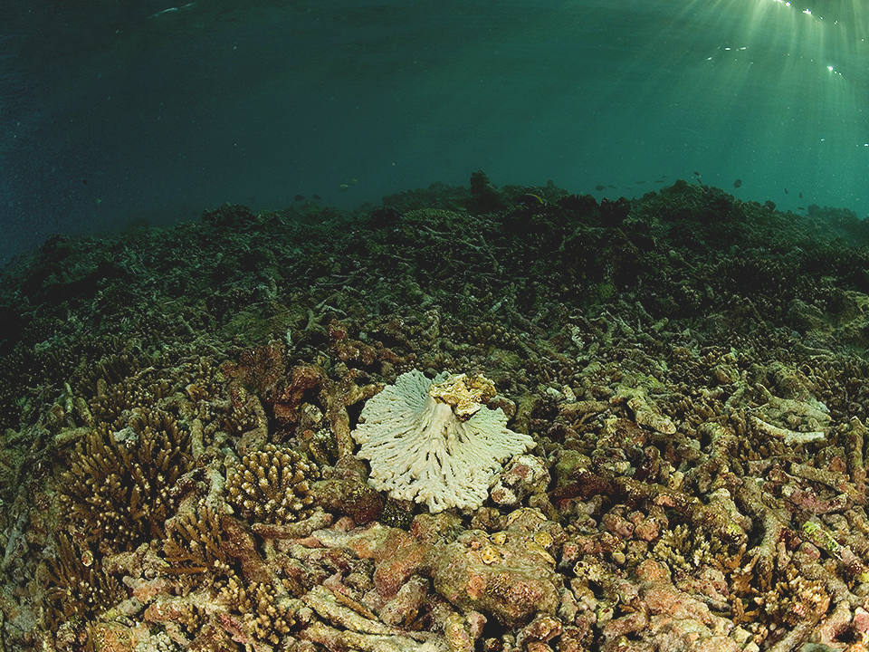
OBSERVED IMPACTS
OF CLIMATE CHANGE
ARE WIDESPREAD
AND CONSEQUENTIAL

Slide 4
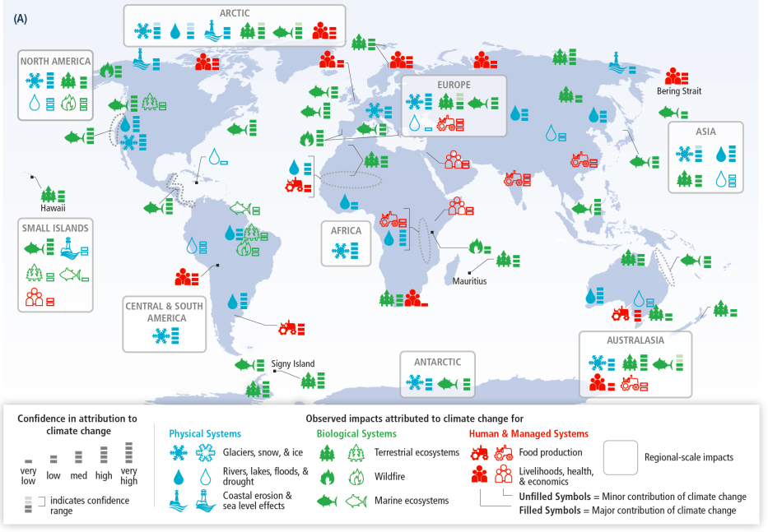

Slide 5
2
0
-2
-4
90th Percentile
YIELD IMPACT
(% Change per Decade)
75th Percentile
-6
Median
25th Percentile
Wheat
Soy
Rice
Maize
10th Percentile
CROP TYPE

Slide 6
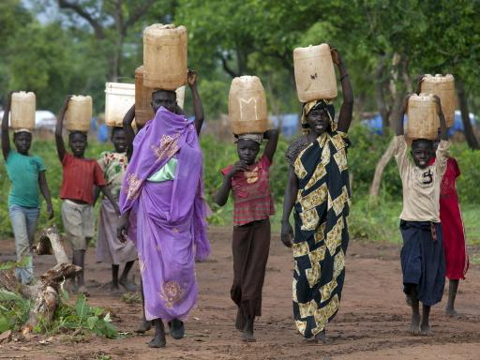
PEOPLE, SOCIETIES,
AND ECOSYSTEMS
AROUND THE WORLD
VULNERABLE
AND EXPOSED
IN DIFFERENT WAYS

Slide 7
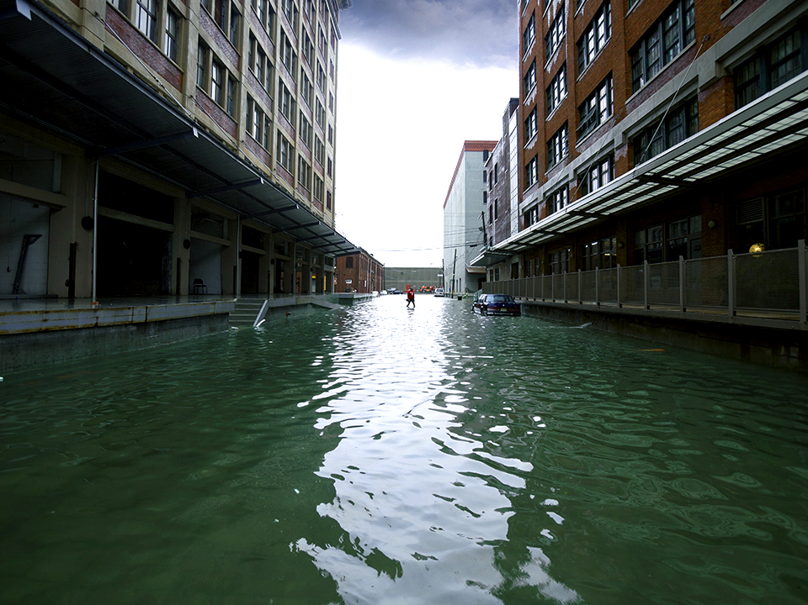
PEOPLE, SOCIETIES,
AND ECOSYSTEMS
AROUND THE WORLD
VULNERABLE
AND EXPOSED
IN DIFFERENT WAYS

Slide 8
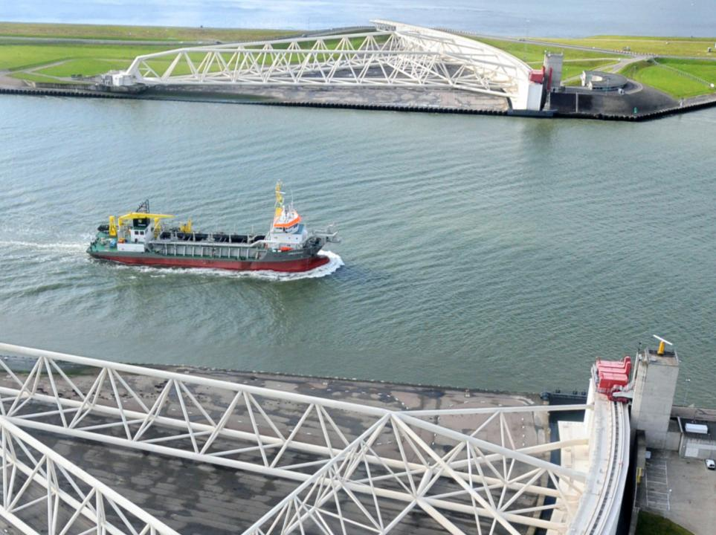
ADAPTATION IS
ALREADY OCCURING

Slide 9
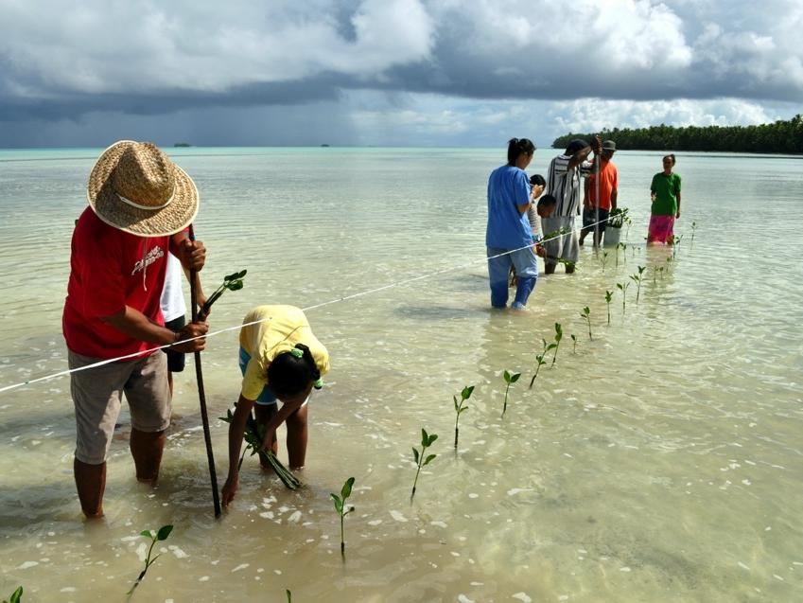
ADAPTATION IS
ALREADY OCCURING

Slide 10

Adaptation is already occurring
Disaster Risk Management
Basic Public Health
Livelihood Diversification
Notes:
Run through some of the examples.
Around the world, people are starting to incorporate climate change into their thinking and planning for the future, and this is starting to translate into concrete actions aiming to make people more prepared for the impacts of climate change.
Much of the report is about what we are learning from these early steps, and how we can use this learning to better prepare going forward.

Slide 11
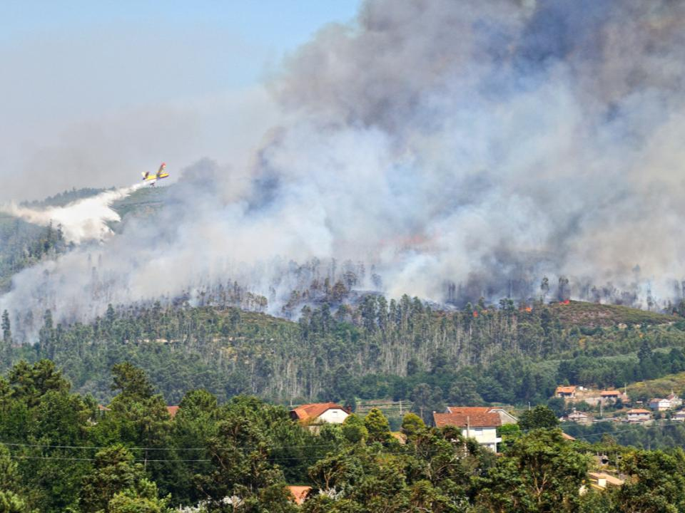
INCREASING MAGNITUDES
OF WARMING INCREASE
THE LIKELIHOOD OF
SEVERE AND
PERVASIVE IMPACTS

Slide 12
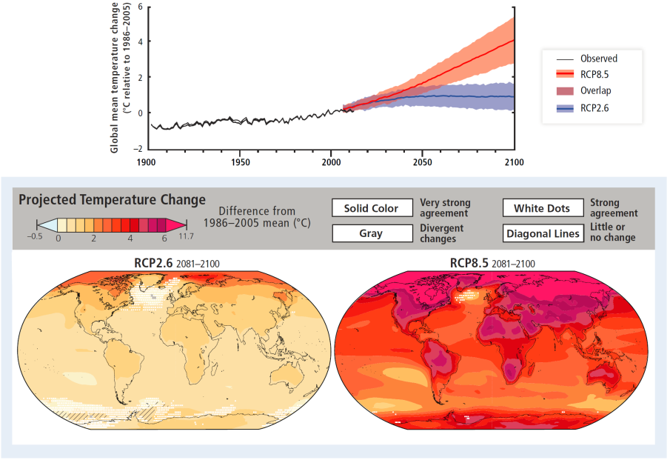
Warming over the 21st century
Notes:
First click brings on first white arrow, second click brings on second white arrow
(B) Observed and projected future
global annual average temperature relative to 1986-2005. Observed warming from 1850-1900 to
1986-2005 is 0.61°C (5-95% confidence interval: 0.55 to 0.67°C). Black lines show temperature
estimates from three datasets. Blue and red lines and shading denote the ensemble mean and
±1.64 standard deviation range, based on CMIP5 simulations from 32 models for RCP2.6 and 39
models for RCP8.5. (C) CMIP5 multi-model mean projections of annual average temperature
changes for 2081-2100 under RCP2.6 and 8.5, relative to 1986-2005. Solid colors indicate areas
with very strong agreement, where the multi-model mean change is greater than twice
the baseline variability (natural internal variability in 20-yr means) and ≥90% of models agree on
sign of change. Colors with white dots indicate areas with strong agreement, where ≥66%
of models show change greater than the baseline variability and ≥66% of models agree on sign of
change. Gray indicates areas with divergent changes, where ≥66% of models show change greater than the baseline variability, but <66% agree on sign of change. Colors with diagonal
lines indicate areas with little or no change, where <66% of models show change greater than
the baseline variability, although there may be significant change at shorter timescales such as
seasons, months, or days. Analysis uses model data (range of grid-point values across RCP2.6
and 8.5: 0.06 to 11.71°C) from WGI AR5 Figure SPM.8, with full description of methods in Box
CC-RC. See also Annex I of WGI AR5.

Slide 13

Assessing risk
Risk Level
Very
Low
Very
High
Med
Present
Near Term (2030-2040)
Long Term
(2080-2100)
2°C
4°C
Risk Level with
High Adaptation
Risk Level with
Current Adaptation
Potential for
Additional Adaptation to Reduce Risk
Notes:
Zero click brings on legend animation, first click brings on Af/Eur/As/Aus, second click brings on the others, third click brings on all
Key risks are potentially severe impacts relevant to Article 2 of the United Nations Framework
Convention on Climate Change, which refers to “dangerous anthropogenic interference with the climate system.” Risks are considered key due to high hazard or high vulnerability of societies
and systems exposed, or both. Identification of key risks was based on expert judgment using the
following specific criteria: large magnitude, high probability, or irreversibility of impacts; timing
of impacts; persistent vulnerability or exposure contributing to risks; or limited potential to
reduce risks through adaptation or mitigation. Key risks are integrated into five complementary
and overarching reasons for concern (RFCs) in Assessment Box SPM.1.
For each key risk, risk levels were assessed for three timeframes. For the present, risk levels
were estimated for current adaptation and a hypothetical highly adapted state, identifying where
current adaptation deficits exist. For two future timeframes, risk levels were estimated for a continuation of current adaptation and for a highly adapted state, representing the potential for
and limits to adaptation.
The risk levels integrate probability and consequence over the widest possible range of potential
outcomes, based on available literature. These potential outcomes result from the interaction of
climate-related hazards, vulnerability, and exposure. Each risk level reflects total risk from
climatic and non-climatic factors. Key risks and risk levels vary across regions and over time,
given differing socioeconomic development pathways, vulnerability and exposure to hazards,
adaptive capacity, and risk perceptions. Risk levels are not necessarily comparable, especially
across regions, because the assessment considers potential impacts and adaptation in different
physical, biological, and human systems across diverse contexts. This assessment of risks
acknowledges the importance of differences in values and objectives in interpretation of the
assessed risk levels.
Assessment Box SPM.2 Table 1: Key regional risks from climate change and the potential for
reducing risks through adaptation and mitigation. Each key risk is characterized as very low to
very high for three timeframes: the present, near-term (here, assessed over 2030-2040), and
longer-term (here, assessed over 2080-2100). In the near-term, projected levels of global mean
temperature increase do not diverge substantially for different emission scenarios. For the
longer-term, risk levels are presented for two scenarios of global mean temperature increase (2°C
and 4°C above preindustrial levels). These scenarios illustrate the potential for mitigation and
adaptation to reduce the risks related to climate change. Climate-related drivers of impacts are
indicated by icons.

Slide 14
Africa
Compounded Stress
on Water Resources
Reduced Crop Productivity
and Livelihood and Food Security
Vector- and Water-
Borne Diseases
Present
Near-term
2°C world, 2100
4°C world, 2100
WATER
FOOD
HEALTH
Notes:
Zero click brings on legend animation, first click brings on Af/Eur/As/Aus, second click brings on the others, third click brings on all
Key risks are potentially severe impacts relevant to Article 2 of the United Nations Framework
Convention on Climate Change, which refers to “dangerous anthropogenic interference with the climate system.” Risks are considered key due to high hazard or high vulnerability of societies
and systems exposed, or both. Identification of key risks was based on expert judgment using the
following specific criteria: large magnitude, high probability, or irreversibility of impacts; timing
of impacts; persistent vulnerability or exposure contributing to risks; or limited potential to
reduce risks through adaptation or mitigation. Key risks are integrated into five complementary
and overarching reasons for concern (RFCs) in Assessment Box SPM.1.
For each key risk, risk levels were assessed for three timeframes. For the present, risk levels
were estimated for current adaptation and a hypothetical highly adapted state, identifying where
current adaptation deficits exist. For two future timeframes, risk levels were estimated for a continuation of current adaptation and for a highly adapted state, representing the potential for
and limits to adaptation.
The risk levels integrate probability and consequence over the widest possible range of potential
outcomes, based on available literature. These potential outcomes result from the interaction of
climate-related hazards, vulnerability, and exposure. Each risk level reflects total risk from
climatic and non-climatic factors. Key risks and risk levels vary across regions and over time,
given differing socioeconomic development pathways, vulnerability and exposure to hazards,
adaptive capacity, and risk perceptions. Risk levels are not necessarily comparable, especially
across regions, because the assessment considers potential impacts and adaptation in different
physical, biological, and human systems across diverse contexts. This assessment of risks
acknowledges the importance of differences in values and objectives in interpretation of the
assessed risk levels.
Assessment Box SPM.2 Table 1: Key regional risks from climate change and the potential for
reducing risks through adaptation and mitigation. Each key risk is characterized as very low to
very high for three timeframes: the present, near-term (here, assessed over 2030-2040), and
longer-term (here, assessed over 2080-2100). In the near-term, projected levels of global mean
temperature increase do not diverge substantially for different emission scenarios. For the
longer-term, risk levels are presented for two scenarios of global mean temperature increase (2°C
and 4°C above preindustrial levels). These scenarios illustrate the potential for mitigation and
adaptation to reduce the risks related to climate change. Climate-related drivers of impacts are
indicated by icons.

Slide 15
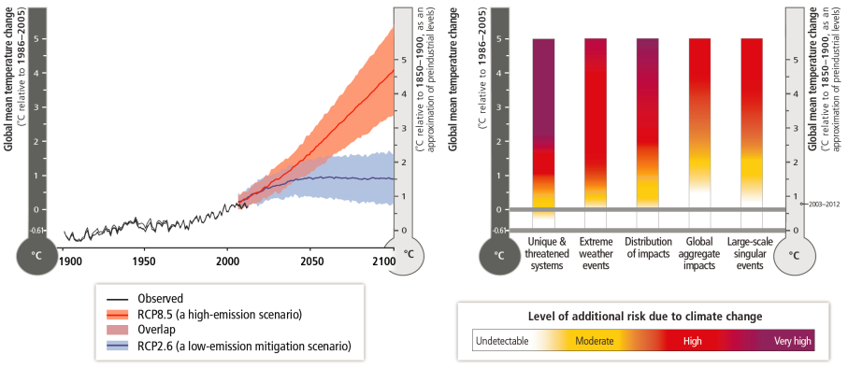

Slide 16

EFFECTIVE CLIMATE
CHANGE ADAPTATION
A MORE VIBRANT WORLD

Slide 17




Vulnerability & Exposure
Vulnerability & exposure reduction
Low-regrets strategies & actions
Addressing multidimensional inequalities
Socioeconomic pathways
Diverse values & objectives
Climate resilient pathways
Transformation
IMPACTS
Adaptation & Interactions
with Mitigation
Incremental & transformational adaptation
Co-benefits, synergies, & trade-offs
Context-specific adaptation
Complementary actions
CLIMATE
SOCIOECONOMIC
PROCESSES
Vulnerability
Natural
Variability
Vulnerability
Socioeconomic
Pathways
Socioeconomic
Pathways
RISK
Hazards
Risk
Adaptation and
Mitigation Actions
Adaptation and Mitigation Actions
Anthropogenic
Climate Change
Anthropogenic
Climate Change
Exposure
Governance
Governance
Risk
Risk assessment
Iterative risk management
Risk perception
Exposure
Governance
Decision- making under uncertainty
Learning, monitoring, & flexibility
Coordination across scales
Anthropogenic
Climate Change
Mitigation
EMISSIONS
and Land-use Change
Notes:
First click shrinks figure and brings on mitigation, second = V/E, third = risk, fourth = SE, fifth = A/M, sixth = governance
The solution space. Core concepts of the WGII AR5, illustrating overlapping
entry points and approaches, as well as key considerations, in managing risks related to climate
change, as assessed in this report and presented throughout this SPM. Bracketed references
indicate sections of this summary with corresponding assessment findings.
Approaches for managing the risks of climate change. These approaches should be
considered overlapping rather than discrete, and they are often pursued simultaneously.
Mitigation is considered essential for managing the risks of climate change. It is not addressed in
this table as mitigation is the focus of WGIII AR5. Examples are presented in no specific order
and can be relevant to more than one category.

Slide 18
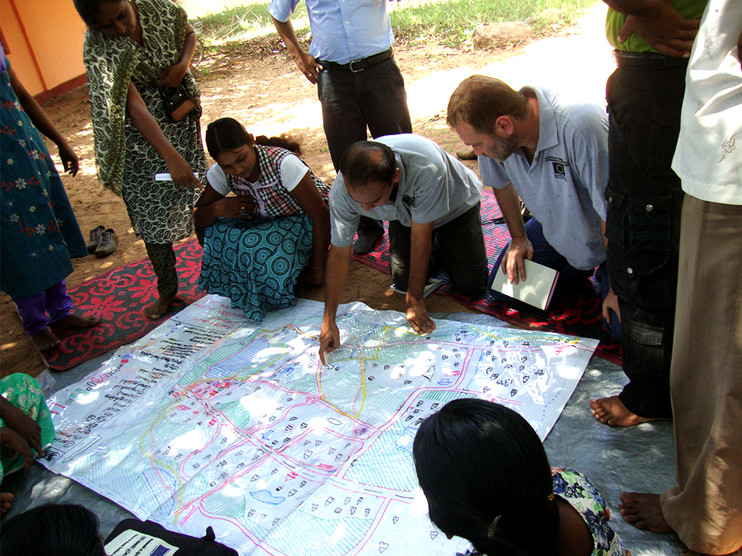
CLIMATE CHANGE
REDUCING AND
MANAGING RISKS
Notes:
Colombo, Sri Lanka.
Climate variability and extremes have long been important in many decision-making contexts.
Climate-related risks are now evolving over time due to both climate change and development.
This section builds from existing experience with decision-making and risk management. It
creates a foundation for understanding the report’s assessment of future climate-related risks and
potential responses.
Responding to climate-related risks involves decision-making in a changing world, with
continuing uncertainty about the severity and timing of climate-change impacts and with
limits to the effectiveness of adaptation (high confidence). Iterative risk management is a
useful framework for decision-making in complex situations characterized by large potential
consequences, persistent uncertainties, long timeframes, potential for learning, and multiple
climatic and non-climatic influences changing over time. See Figure SPM.3. Assessment of the
widest possible range of potential impacts, including low-probability outcomes with large
consequences, is central to understanding the benefits and tradeoffs of alternative risk
management actions. The complexity of adaptation actions across scales and contexts means that
monitoring and learning are important components of effective adaptation.27

