Slide 1
What does it mean for Ethiopia’s development?
Uganda’s low carbon development opportunities
Shuaib Lwasa, Lead Author WG 3
Makerere University
Date 21st August 2014

Slide 2
Confidence
Framework for Assessment and evaluation of evidence and agreement into a judgment about the validity of findings
Probabilistic estimate embedded in confidence scale

Slide 3

Climate change, a global
commons problem: The drivers

Slide 4
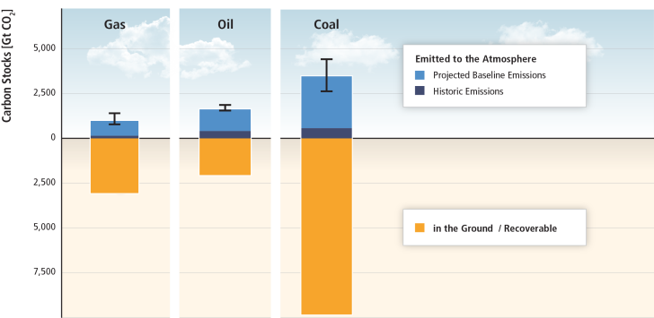
There is far more carbon in the ground than emitted in any baseline scenario.
Based on SRREN Figure 1.7
Economic Growth and Population will most likely continue to dominate extraction and consumption of these resources

Slide 5

GHG emissions growth has accelerated despite reduction efforts.

Slide 6
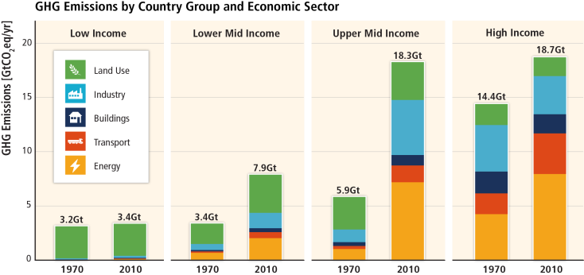
Regional patterns of GHG emissions are shifting along with changes in the world economy.

Slide 7
Limiting warming to 2°C involves substantial technological, economic and institutional challenges.
WG III SPM AR5

Slide 8
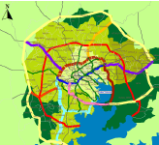
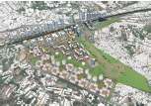

Human Settlements,
Infrastructure, and
Spatial Planning

Slide 9
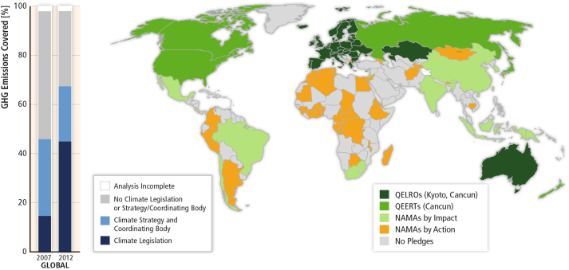
There has been a considerable increase in national and sub-national mitigation policies since AR4.
Based on Figures 15.1 and 13.3

Slide 10
Not IPCC finding but a local example
Based on 2012 baseline ~ Mt 42,960 from transportation over a period of 25 years.
The BRT NAMA targets reduction by 30%

Slide 11
The anticipated growth in urban population will require a massive build-up of urban infrastructure, which is a key driver of emissions across multiple sectors limited evidence, high agreement
WG III CH_12
In Africa, the urban population is growing faster
UN-Habitat 2012/2013

Slide 12
That is happening in the second urbanization wave which is dependent on significant increases in global resource extraction and consumption
Swilling et al 2012

Slide 13
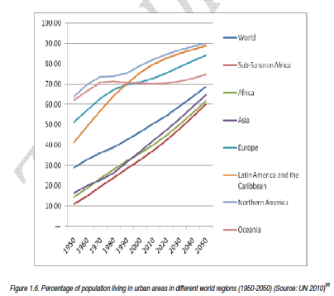
What does it mean for Ethiopia?
In the second urbanization wave, Africa and Uganda in particular is highly urbanizing
New urban developments driven by resource extractive industry

Slide 14
What does it mean for Uganda?
Although cities only occupy 4% of the
earth’s land surface, 75% of all natural resources are consumed within cities, and as of 2007
Urbanization nationally and Kampala’s growth was at 3.72% by 2010 with a share of national population of 4.7% and projected share of 6.09% in 2025
Importance of taking action about small-medium sized cities
Source: OpenData_IUWM_31citiesAfrica accessed 2013

Slide 15
Key issues from findings for Uganda
Infrastructure and urban form are strongly linked, especially among transportation infrastructure provision, travel demand and vehicle kilometres travelled (robust evidence, high agreement).
Key urban form drivers of energy and GHG emissions are density, land use mix, connectivity, and accessibility (medium evidence, high agreement)

Slide 16
Key Opportunities
The largest opportunities for future urban GHG emissions reduction are in rapidly urbanizing areas where urban form and infrastructure are not locked-in, but where there are often limited governance, technical, financial, and institutional capacities (robust evidence, high agreement)
Greening urban systems, ecological enhancement, opportunities creation are important for cities in this wave

Slide 17
Key Issues for mitigation in Uganda
Successful implementation of urban climate change mitigation strategies can provide co-benefits (robust evidence, high agreement).
Thousands of cities are undertaking climate action plans, but their aggregate impact on urban emissions is uncertain (robust evidence, high agreement)
The feasibility of spatial planning instruments for climate change mitigation is highly dependent on a city’s financial and governance capability (robust evidence, high agreement).

Slide 18
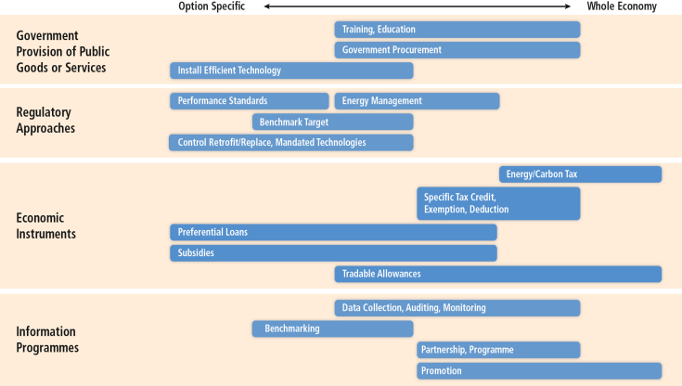
Sector-specific policies have been more widely used than economy-wide policies.
Based on Figure 10.15

Slide 19

Options of urban policies for reduction of emissions

Slide 20
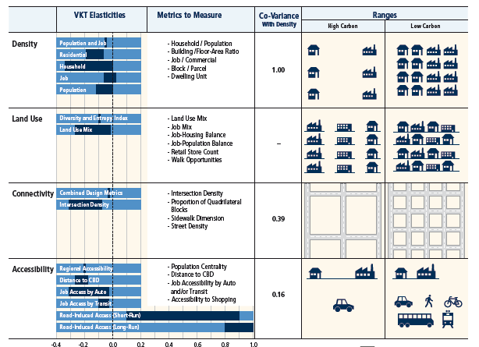
Key Policy Options for consideration Ethiopia

Slide 21
Conclusion
Cities and national governments have started to work towards reducing GHG emissions
But future urban trajectories indicate that most likely cities will grow as extraction and consumption patterns change
Reducing GHG emissions from cities and making them sustainable is key to a national, regional and global cumulative reduction of emissions

