Slide 1
AGRICULTURAL RESEARCH SCIENCE INITIATIVE – contribution to climate change adaptation and mitigation
KOMUTUNGA EVERLINE (PhD)
Agro-meteorologist
National Agricultural Research Organization, Kampala Uganda

Slide 2
PRESENTATION OUTLINE
Introduction
Crop science initiative
Pest and diseases management
4. National Agricultural laboratories
5. Other science

Slide 3
One of the pillars of the DSIP
  Research and technology development

Slide 4
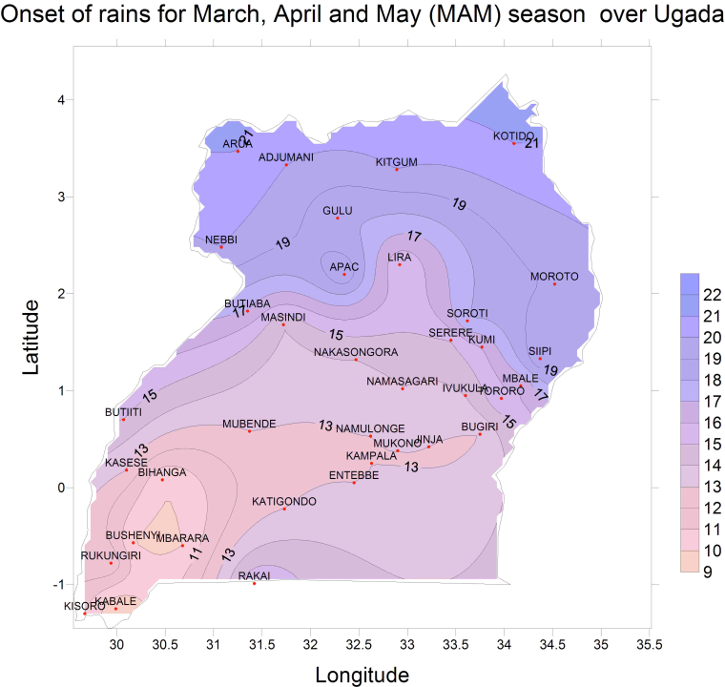

Slide 5
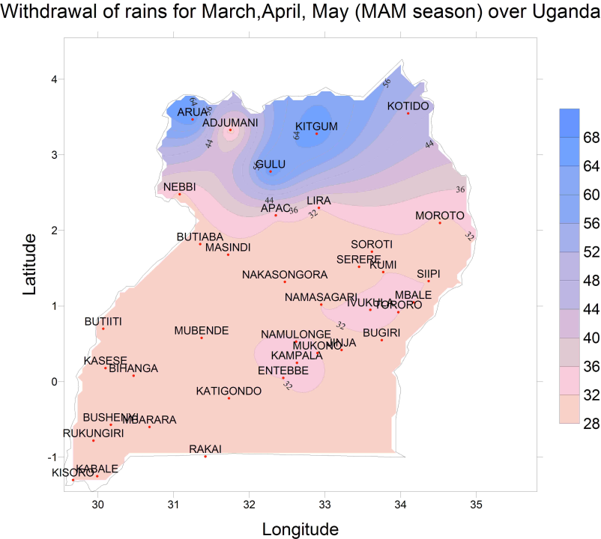

Slide 6
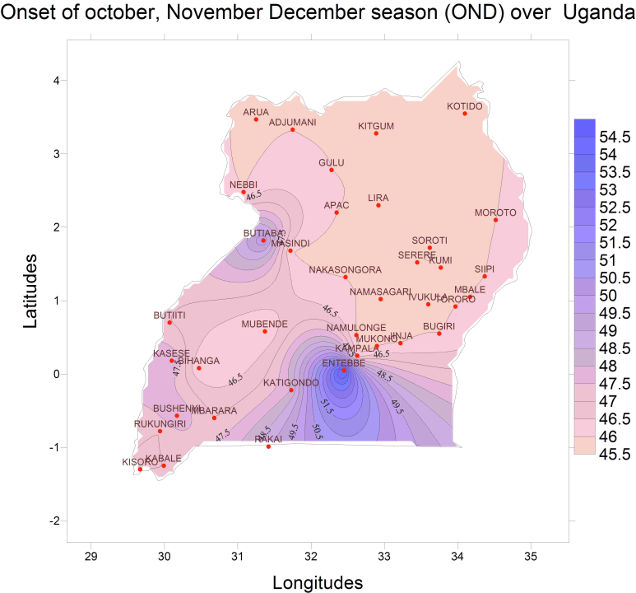

Slide 7
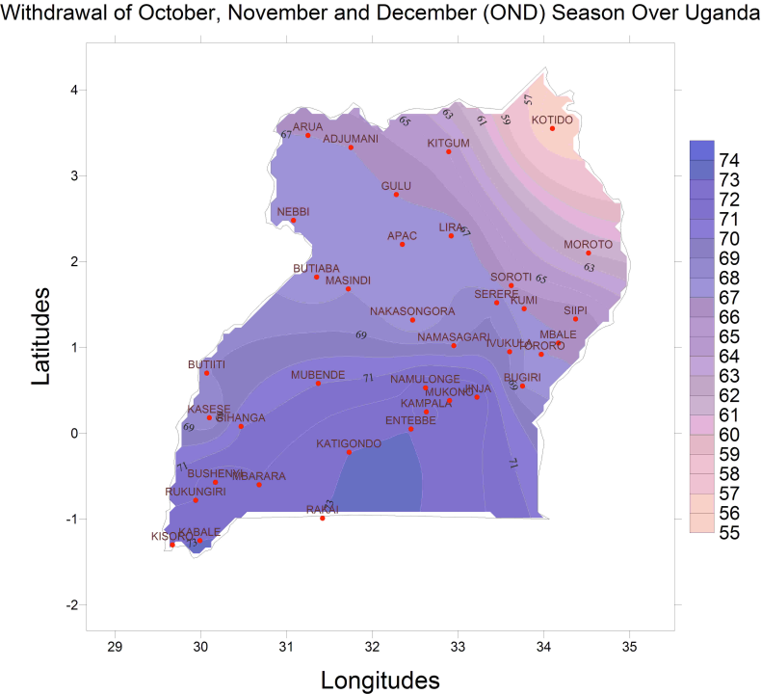

Slide 8
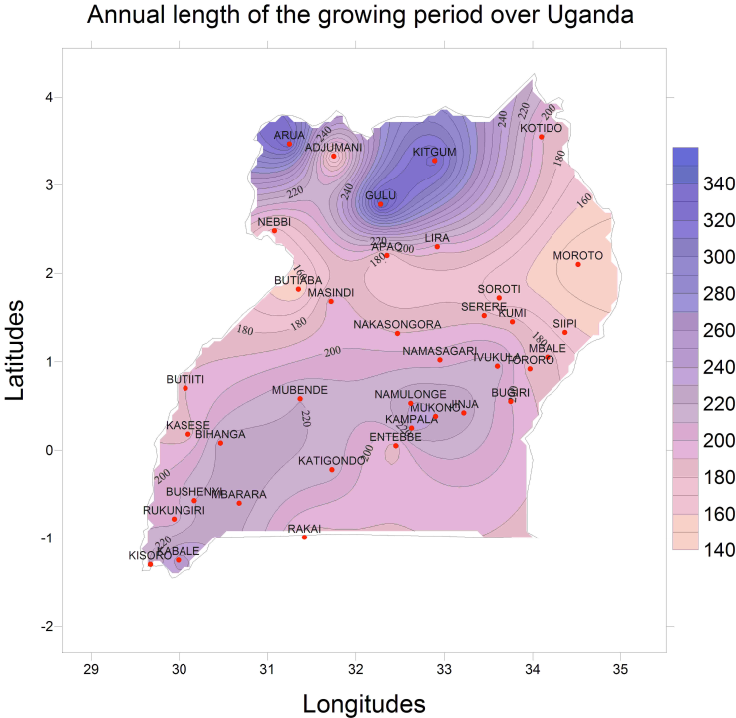

Slide 9
1. Drought and heat tolerant varieties
Cassava
Beans
Fruit trees
Millet
Sorghum
Cowpeas
banana

Slide 10
2. Short duration crops
Beans (60 days)
Potatoes (60-90 days)
Assorted vegetables under the horticulture Research
sorghum
3. increased pests and diseases
Breeding for tolerance
Improved management

Slide 11
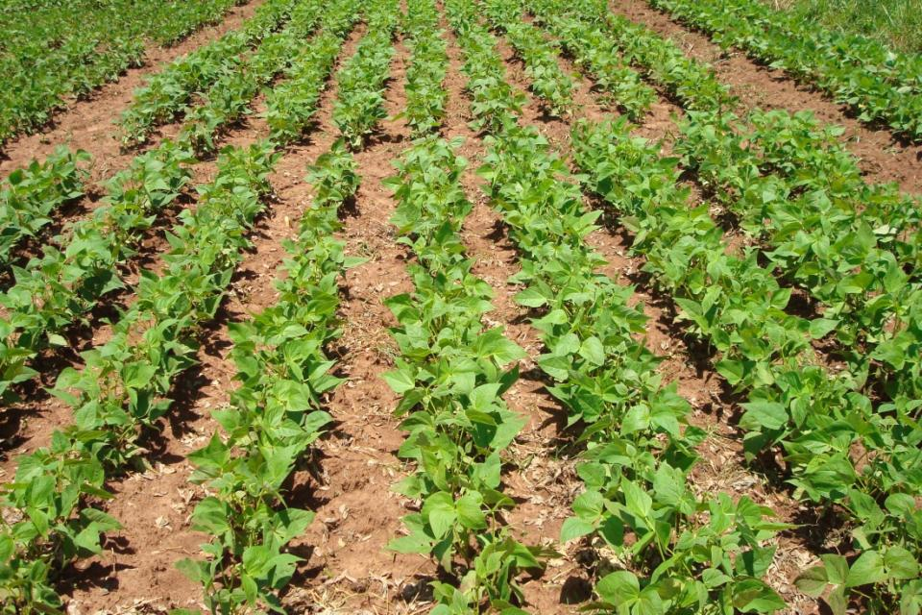
Crop research related to climate risk
1. Development of drought and heat tolerant varieties
- cassava
Beans
Potatoes
Horticultural crops including fruit trees
Cowpeas
Sorghum
Millet
Rice (paddy and upland)

Slide 12
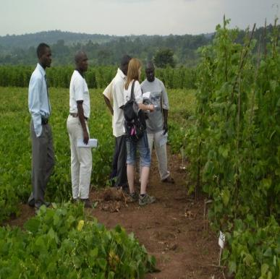

Slide 13
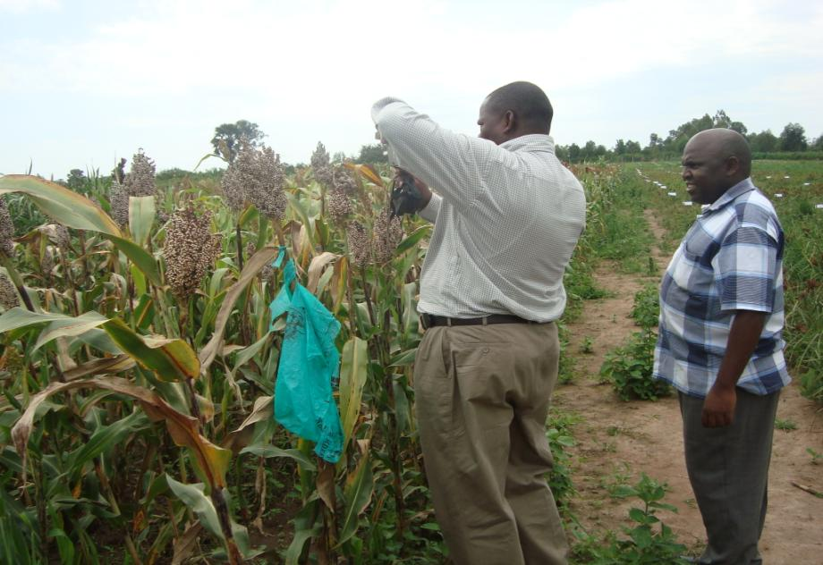

Slide 14
Banana hybrids developed and promoted
Options for BBW control promoted in main banana growing areas

Slide 15
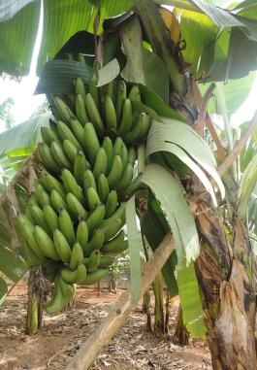
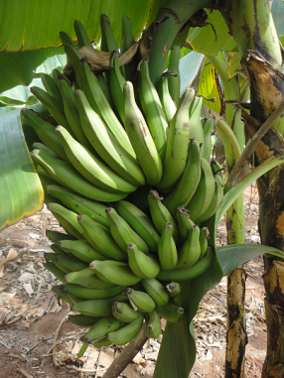
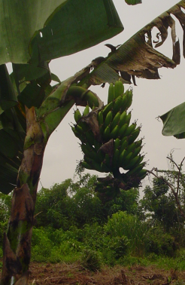
M19 (12603S-1)
M20 (12571S-15)
Local variety Mbwazirume
Attributes
Black Sigatoka resistant
Yields =26.5 ton/ ha/ yr
Attributes
Black Sigatoka resistant
Yields= 28.1 ton/ ha/ yr
Attributes
Susceptible to Black Sigatoka
Yields=11.9 ton/ha/yr

Slide 16
Laboratories
Under agricultural engineering
Development of agricultural labor saving machines
(reducing drudgery in farm practices)
– ploughs, planters, choppers
Development of post harvest handling machines
Maize shelling
Cassava chipper
Rice shelling

Slide 17
Water delivery systems
-Ram pump
Assorted water harvesting and delivery systems
Energy efficient systems research
Fireless cooker
Wind energy

Slide 18
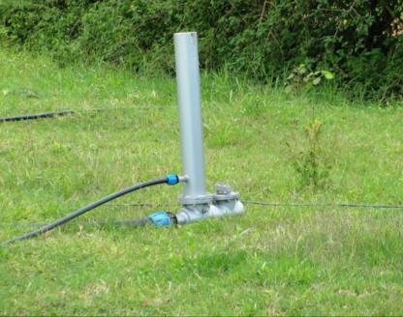
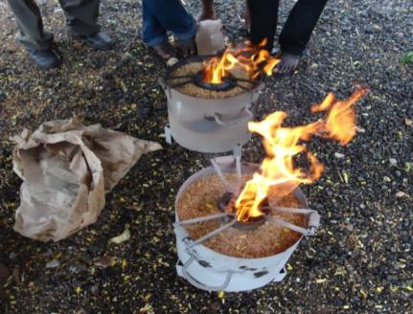
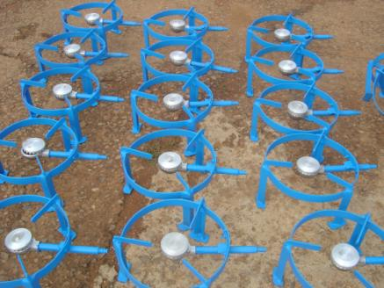
Low head ram pump
Biomass stoves
Biogas stoves

Slide 19
Post harvesting technology development
Management of post harvest pests and diseases
research
Agribusiness for enterprise diversification
business incubation of generated research
technologies and innovations
food bio-sciences
-Food safety - during periods of extreme humidity
and technologies to improve Safety
-Development of protocepts

Slide 20
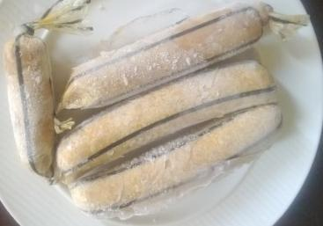
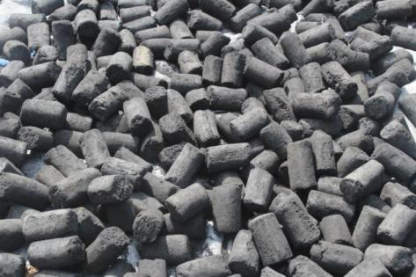
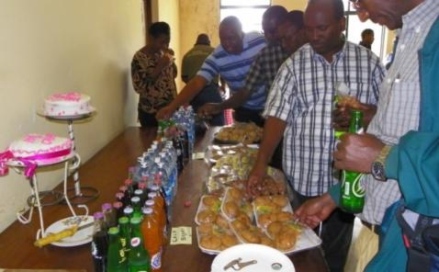
VAC Incubatee products

Slide 21
Sustainable land and water management
    Restoration of degraded lands and watershed
    management technologies
    Soil information system
    soil map,
    nutrient distribution
    Soil and water conservation
    technologies that reduce soil erosion,
    soil and nutrient loss including conservation
    agriculture

Slide 22
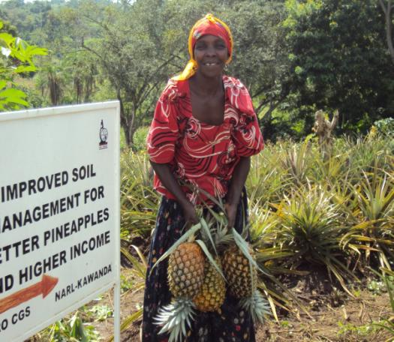
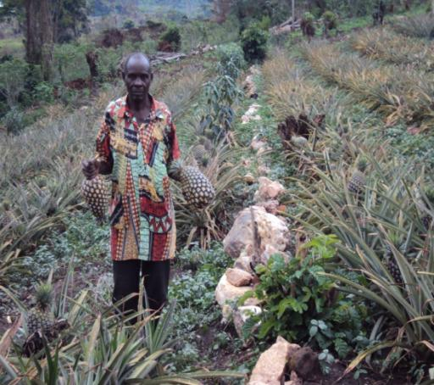

Slide 23
    Soil fertility management
    Developed fertilizer optimization tool
    Developing substitution ratios for organic to
    inorganic fertilizers

Slide 24
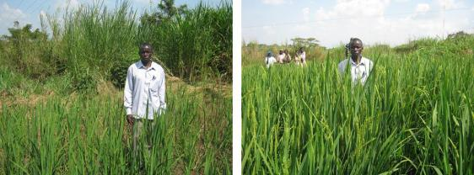
Mean upland rice response to Integrated Soil Fertility Management Technologies
Sites:
Semuto & Kapeka SC(Nakaseke District)
Ivukula, Nsinze and Namutumba SC (Namutumba District)
Farmers Practice +(50 kg N + 15kg P)/ha

Slide 25
    Climate change adaptation and mitigation
    Data management
    Crop yield monitoring and yield projections
    Crop suitability mapping
    Information packaging and dissemination ( cropping calendars)

Slide 26
close association between soil productivity and current banana growing areas.

Slide 27
Two degree increase in temperature will result in the disappearance of the highly suitable area (100%) to suitable (80%).
The climatically suitable areas shown in deep green (excellent (100%, light (suitable 80%) and lighter ( 60% suitable).

Slide 28
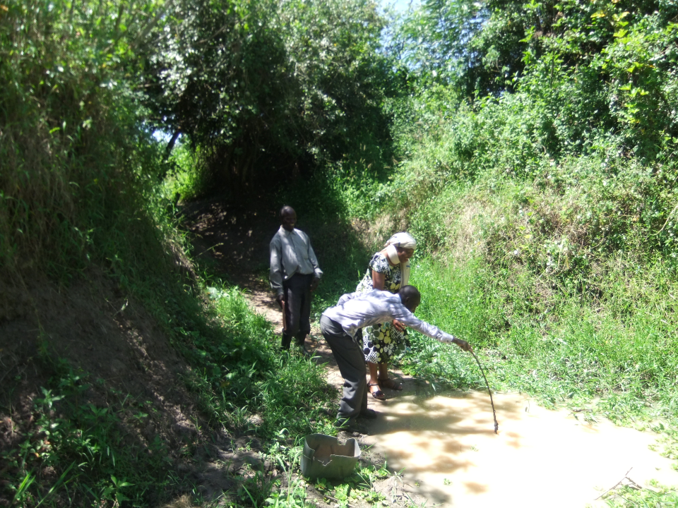

Slide 29
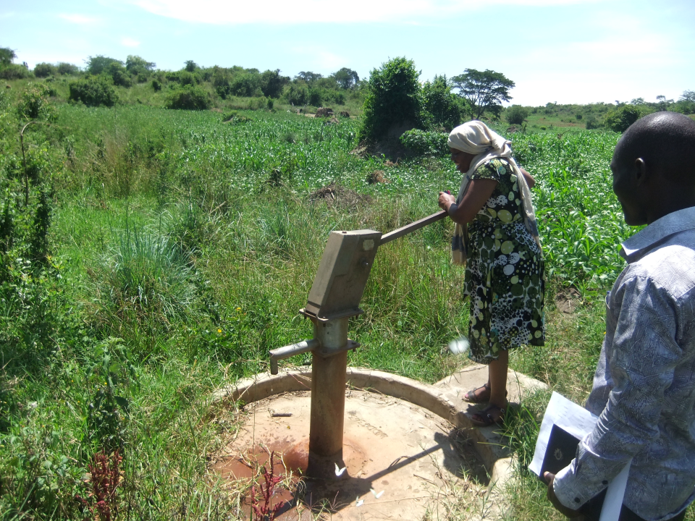

Slide 30
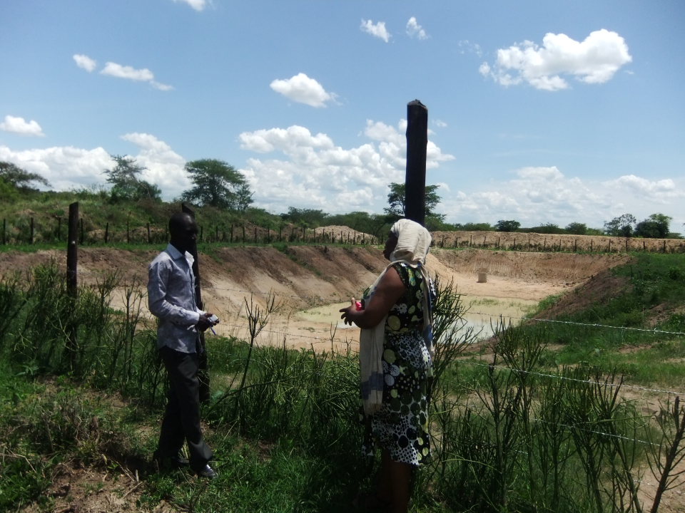

Slide 31
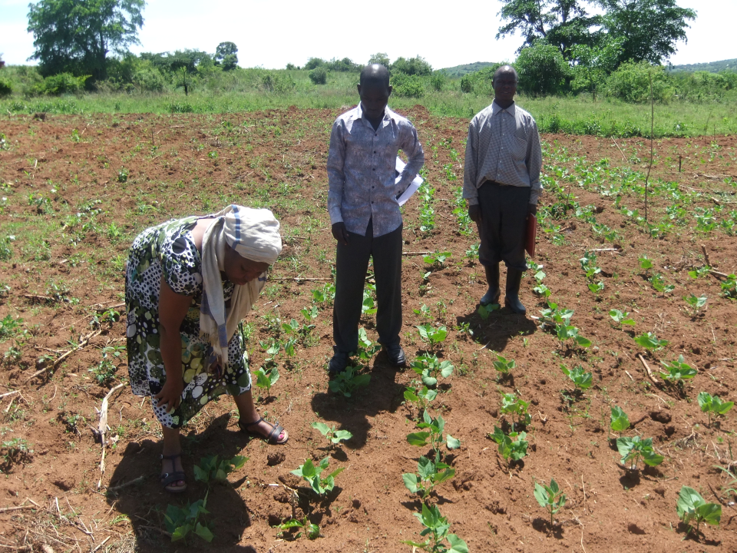

Slide 32
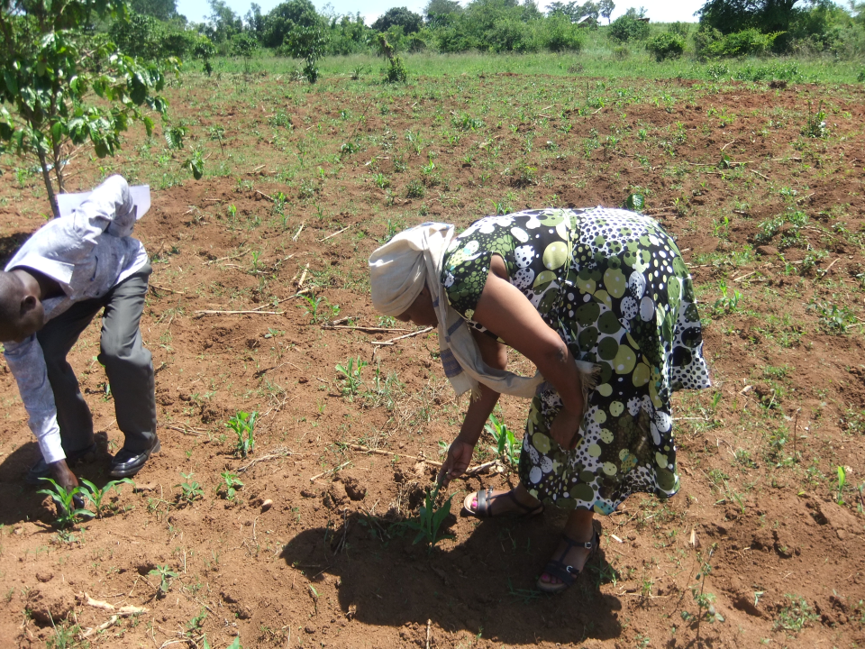

Slide 33
    Conservation of at least 700 new accessions characterisation of 20 core collections and enhanced management for sustainable utilization of selected Plant Genetic Resources
    biotechnology systems, diagnostics and processes developed for improved productivity of selected crops

Slide 34
    Forestry and agroforestry research
    Carbon stocks in divers tree species
    Shed systems in coffee systems
    Soil improving tree species
    Fisheries research
    Capture fisheries as diversification options

Slide 35
    LIVESTOCK
    Breeding for hardy indigenous types
    Dry season feeding technologies

