Slide 1
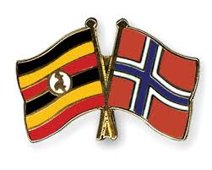



NORHED-MAK FUNDED PROJECTS AT GLANCE
NORHED - Norwegian Programme for Capacity Building in Higher Education and Research for Development

Slide 2
Makerere NORHED Competitiveness
Largest number of NORHED projects won globally (13/46) granted globally
Involved in 13 projects, providing leadership in 9
Will jointly produce over 60 PhD graduates
Over $30 million granted under the projects
Will be implemented for 5 years

Slide 3
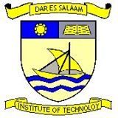

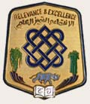









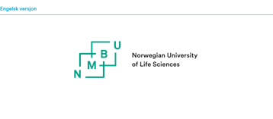
MAK-NORHED Partnerships

Slide 4
Hi-Train health informatics training and Research in East Africa for Improved Health Care.

Slide 5

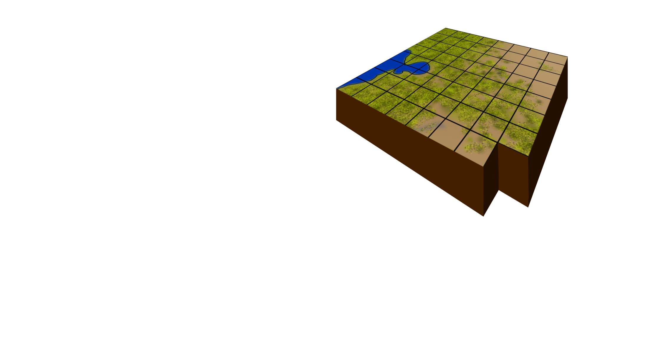

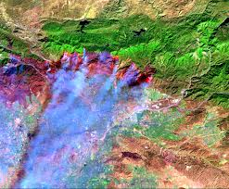
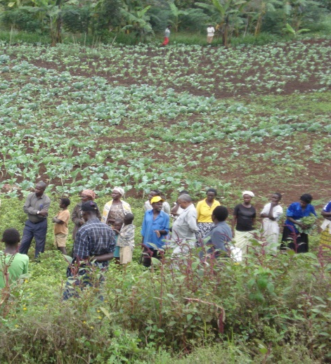

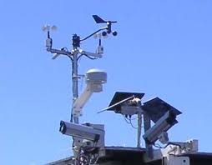
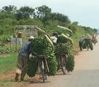

Regional Capacity Building for Sustainable Natural Resource Management and Agricultural Improvement under Climate Change
Partners

Slide 6
Water and Society (WaSo-Africa) - Institutional Capacity Building in Water Management and Climate Change Adaptation in the Nile Basin.

Slide 7
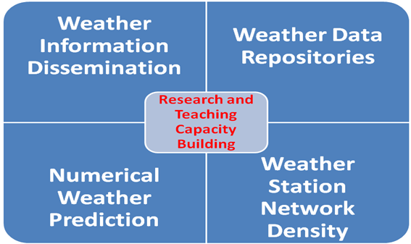

WIMEA-ICT:
Improving Weather Information Management in East Africa for effective service provision through the application of suitable ICTs
Improve the accuracy of and access to weather information in East Africa through ICTs for increased productivity and safety
Partners
Notes:
focus on wake effects; near and far

Slide 8
Building capacity for REDD+ in East Africa for improved ecosystem health and for sustainable livelihoods in Eastern Africa (UGA-13/0019)
Prof. John RS Tabuti (Principal Investigator)
REDD+ is aimed at supporting activities to reduce CO₂ emissions that are caused by deforestation and forest degradation
This project is a partnership between Makerere University (Mak), University of Dar es salaam (UDSM) and the Norwegian University of Life Sciences (NMBU)
The project is being implemented at Mak and UDSM with the goal of Strengthening capacity for education and research on climate change and REDD+ at Mak and UDSM.
The main outputs are:
Develop capacity for REDD+ implementation and coordination
Build an information system for REDD+
Notes:
REDD+ stands for Reducing Emissions from Deforestation and Forest Degradation, ‘plus’ conservation of forests, enhancement of forest carbon stocks and sustainable management of forests.

Slide 9



Building and Reflecting on
Interdisciplinary PhD Studies for
Higher Education Transformation
Makerere Institute of Social Research (MISR)
College of Humanities and Social Sciences
Makerere University
In Partnership with
UiB Global, University of Bergen

Slide 10
Survival - Pluss: Increasing capacity for mama-baby survival in post-conflict Uganda and South Sudan under the theme of Health

Slide 11




Leapfrogging 1st Generation Distance Education into 4th and 5th Generation Distance Education: A Strategy for Enhancing ICT Pedagogical Integration and Increasing Access to Education in Africa
Partner

Slide 12
BORDERLAND DYNAMICS IN EAST AFRICA. A network program for capacity building within departments of social anthropology in East African Universities.
The Project shall be run in collaboration with the (1) Department of Social Anthropology, Addis Ababa University, Ethiopia, (2) Department of Sociology and Anthropology, University of Khartoum, Sudan, and (3) Department of Sociology and Anthropology, Makerere University,
Other Partner Institution(s): Organisation for Social Science Research in eastern and Southern Africa (OSSREA), in the North: Department of Social Anthropology, University of Bergen and Chr. Michelsens Institute (CMI))
Train; PhD & Masters, conduct dissemination

Slide 13

Capacity building in Zoonotic diseases Management using Integrated Ecosystems health and gender-focused approach ( CAPAZOMANITECO) at the human-livestock –wildlife interface in the Eastern and Southern Africa
Partners

Slide 14
BORDERLAND DYNAMICS IN EAST AFRICA. A network program for capacity building within departments of social anthropology in East African Universities.
The Project shall be run in collaboration with the (1) Department of Social Anthropology, Addis Ababa University, Ethiopia, (2) Department of Sociology and Anthropology, University of Khartoum, Sudan, and (3) Department of Sociology and Anthropology, Makerere University,
Other Partner Institution(s): Organisation for Social Science Research in eastern and Southern Africa (OSSREA), in the North: Department of Social Anthropology, University of Bergen and Chr. Michelsens Institute (CMI))
Train; PhD & Masters, conduct dissemination

Slide 15
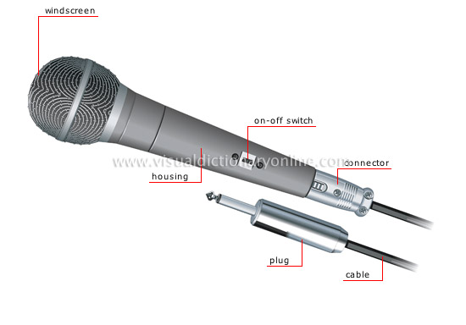
Strengthening Media in Post-Conflict Societies through Education and Research: Bridging Gaps, Building Futures in Uganda, South Sudan, Nepal and Norway

Slide 16
Capacity Building for Training and Research in Aquatic and Environmental Health in Eastern and Southern Africa TRAHESA

