Slide 1
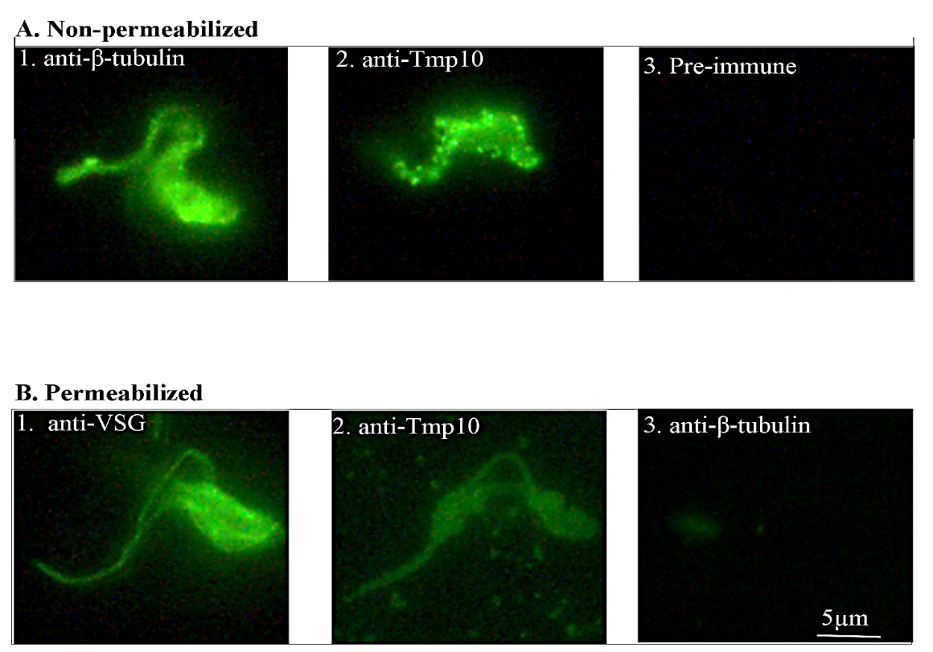
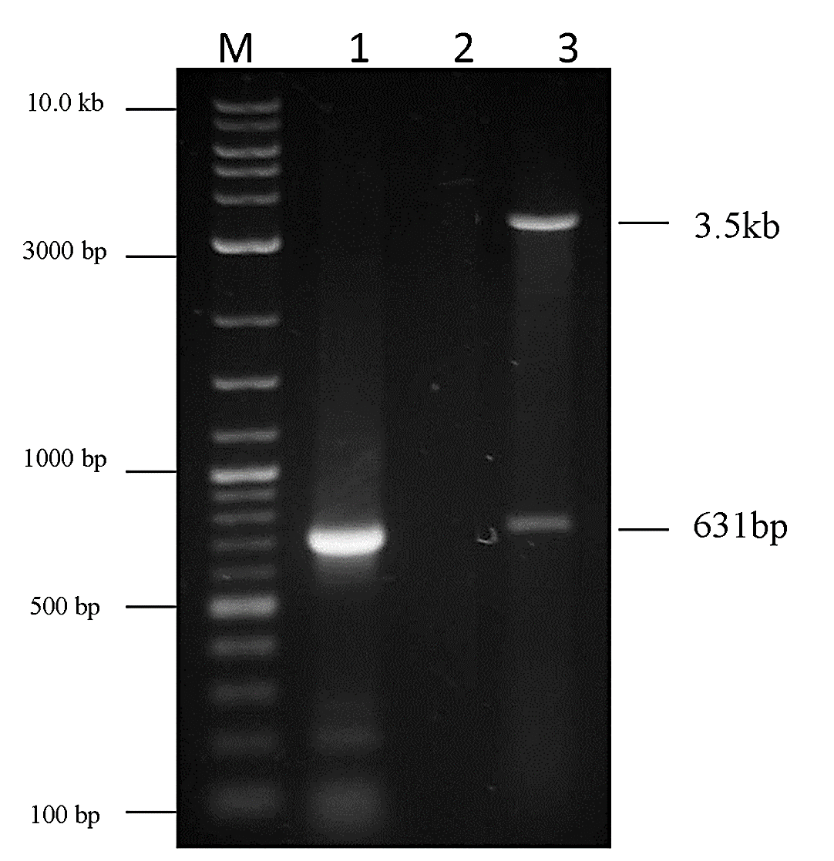
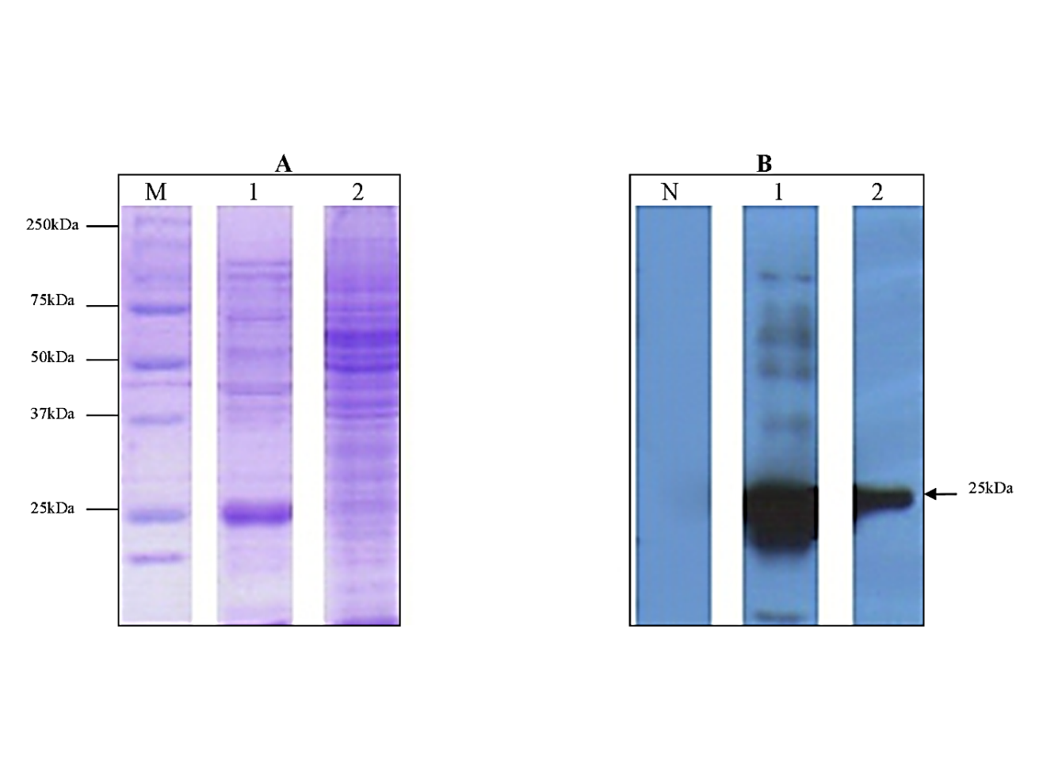
Expression and Localization of a Hypothetical Protein of Trypanosoma brucei Savannah Mwesigwa¹, Monica Namayanja¹, Phillip Magambo¹, Sylvester Ochwo¹, David K. Atuhaire, E. M¹. Wampande¹, & G. W. Lubega¹
¹College of Veterinary Medicine, Animal resources and Biosecurity, Makerere University,
Introduction
Results
Among the parasitic diseases afflicting sub-Saharan Africa, Trypanosomiasis is of a unique status; for this disease, all possible approaches for control of a typical parasitic disease remain unsatisfactory. To date there is no effective vaccine, just a handful of drugs, while diagnostics are limited to the tedious parasitological methods that are of low sensitivity.
The identification and cellular localization of novel proteins in Trypanosoma brucei can provide valuable information for the identification of new drugs, vaccines or diagnostic targets to effectively control this disease. There is now a feasible approach following the publication of the trypanosome genome
Figure 1. Agarose gel detection of the PCR and digestion products of Tmp10. PCR yielded a 631 bp product (Lane 1) with no product in the negative control (Lane 2); A BamHI and HindIII double-digest was carried out on the amplicon and the ~3.5kb vector; pQE30. The PCR product was ligated into the pQE30 vector before transforming E. coli JM105 cells. Ligation was confirmed by HindIII and BamHI double-digest to release the insert from the vector (Lane 3), and visualized by ethidium bromide (50μg/ml) staining on a 1.0% TAE agarose gel with a NEBTM 2-Log DNA Ladder (Lane M).
Figure 3. Immunofluorescence for localization of the Tmp10 antigen. To determine whether the rabbit antiserum was recognizing a surface or internal antigen, indirect immunofluorescence was performed in two ways. For surface antigens (Panel A), a suspension of intact T. b. brucei GVR35 parasites was probed with test serum (1:25 dilution). Pre-immune rabbit serum was added as a negative control (not shown), rabbit anti-VSG was used as a positive control for surface staining of non-permeabilized cells (1), test serum was used to localize Tmp10 (2), mouse anti-β-tubulin mAb (3) was added as a negative control for surface staining to verify membrane integrity. Detection was by FITC conjugated anti-Rabbit IgG (dilutions 1:40) and FITC conjugated anti-mouse IgG for the anti-β-tubulin assay. Panel B shows results of immunofluorescence performed as above except that the cells were permeabilized.
Objectives
To express and localize a hypothetical protein, designated Tmp10, which was predicted to be a surface protein using bioinformatics tools.
Conclusion
These results suggest that Tmp10 is ~25kDA surface protein expressed endogenously by T. brucei brucei. The study also illustrates the merits of mining genome databases using bioinformatics tools as a viable approach to the identification of novel surface proteins which may have vaccine or diagnostic potential.
Methods
Tmp10 was cloned from T. brucei brucei GVR35, expressed in E. coli BL21(DE3) as a partial-length, His-tagged recombinant protein (rTmp10) and purified.
Polyclonal rabbit antibodies against Tmp10 were raised and used to probe Tmp10 by Western blot on T. brucei brucei whole cell lysate.
Indirect immunofluorescence microscopy was performed on Trypanosome cells
Figure 2. SDS-PAGE and Western blot analysis for immunodetection of Tmp10 in T. brucei brucei (GVR35) whole cell lysate. The purified recombinant protein (lane 1) and the trypanosome whole cell lysate (lane 2) were subjected to electrophoresis on a polyacrylamide gel. Half the loaded samples were stained with Coomassie blue R250 (Panel A) and samples in the other half transferred to a nitrocellulose membrane for detection by ECL (Panel B). After blocking, membranes were washed and probed with rabbit anti-rTmp10 (1:3000), a preimmune serum assay was included as a negative control. The membranes were then washed, and incubated with HRP-conjugated goat anti-rabbit IgG mAb (1:10,000), and developed with ECL Western blotting detection reagents. The image shows the protein in the whole cell lysate of similar size as the purified recombinant protein (~25kDA). Lane M; Marker, Lane N; Negative control (Preimmune serum)
References
Berriman, M., Ghedin, E., Hertz-Fowler, C., Blandin, G., Renauld, H., Bartholomeu, D. C., Lennard, N. J., et al. (2005). The genome of the African trypanosome Trypanosoma brucei. Science, 309(5733), 416–422.
Fankhauser, N., & Mäser, P. (2005). Identification of GPI anchor attachment signals by a Kohonen self-organizing map. Bioinformatics, 21(9), 1846–52. doi:10.1093/bioinformatics/bti299 with disease outbreaks in Uganda in 2007. Afr J Biotechnol 2011. 10:3488-3497
Lubega, G.W., Ochola, D. O. K., & Prichard, R. K. (2002). Trypanosoma brucei: anti-tubulin antibodies specifically inhibit trypanosome growth in culture. Experimental parasitology, 102(3-4), 134–142.
This investigation received financial support from Human Frontier Science Program (HFSP) and Grand Challenges Canada

