Slide 1
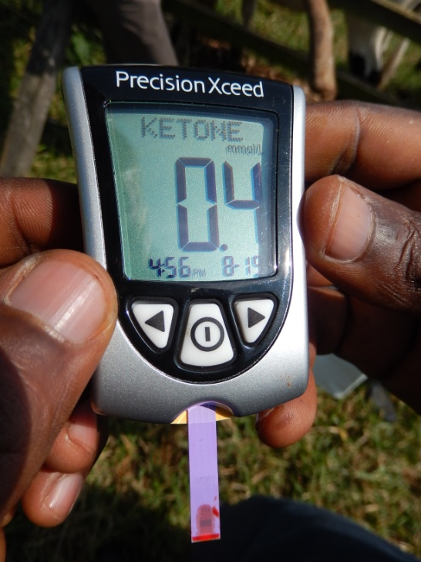
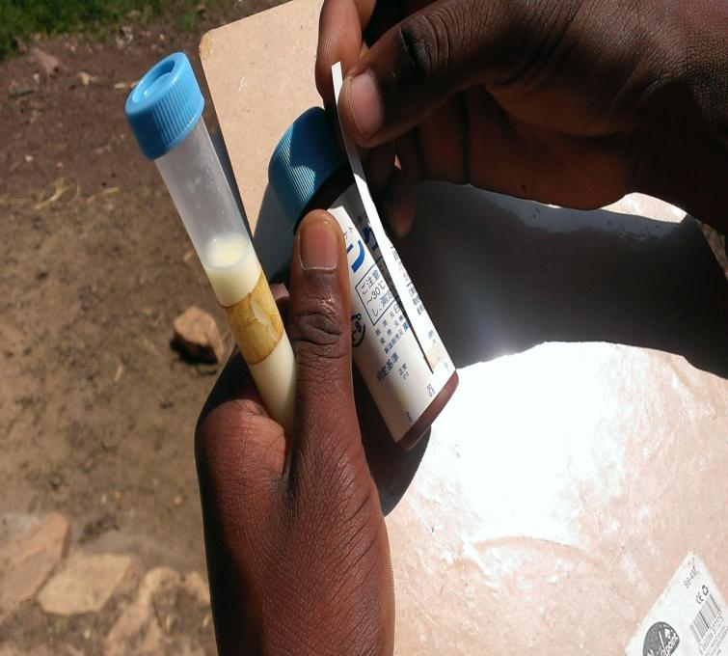
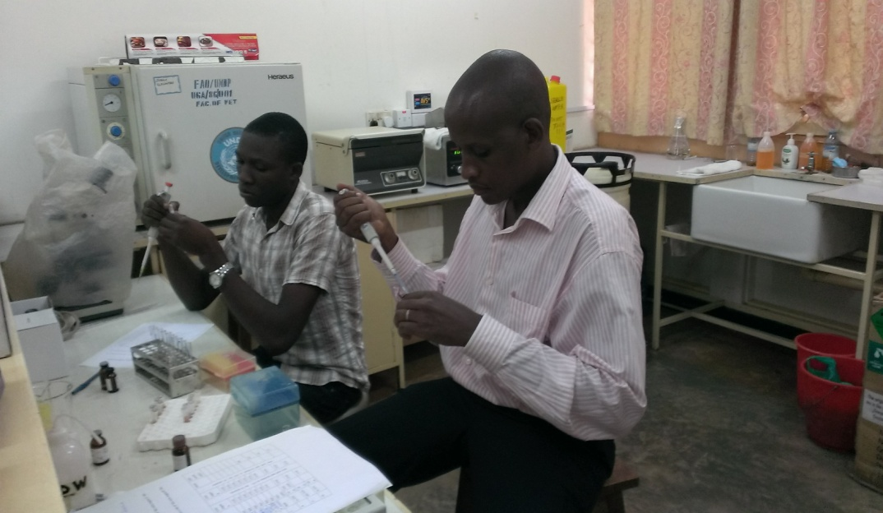
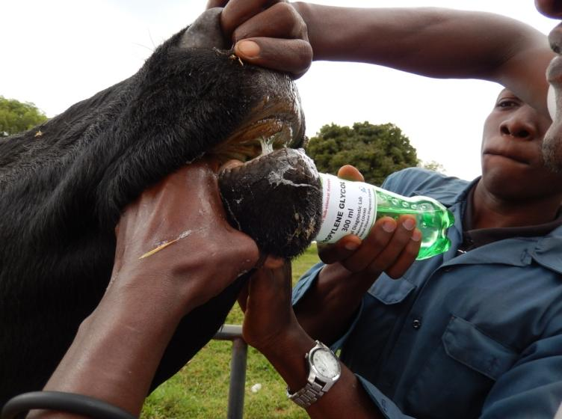
Negative Energy Balance in Transition Period and the Prevalence of Subclinical Ketosis in Early Lactation in Dairy Cattle in the Peri-Urban Kampala
Dr. Tayebwa Dickson¹, Dr. Godfrey Bigirwa², Dr. Benon M. Kanyima², Prof Toshihiko Nakao³
¹Cental Diagnostic Laboratory Makerere University, ²College of Animal Resources and Bio-security Makerere University, ³JICA project on Animal Disease Control Uganda
Introduction and Significance of the study
Effects of Propylene Glycol on Serum NEFA and Blood BHBA in a Cow: A Preliminary Study at CoVAB
Dairy cows face a metabolic challenge in the transition period and in early lactation. Negative energy balance (NEB) within a few weeks before calving and subclinical ketosis (SCK) in early lactation are the major factors causing increased incidence of postpartum diseases, reduced milk production and impaired reproductive performance. Cows in NEB mobilize body fat to produce non-esterified fatty acids (NEFA), In excess breakdown of NEFA (fat), there is production of ketone bodies which are bio-makers of NEB, SCK and whose concentrations can be measured in blood and milk.
The study aimed at showing the prevalence of NEB pre-partum and SCK in early lactation, to know the adverse effects of NEB and SCK on health, production and reproduction in cows and to demonstrate the effectiveness of propylene glycol in managing SCK.
300 ml of Propylene Glycol administered once a day
Blood BHBA
Serum NEFA
Materials and Methodology
A total of 34 farms in the Kampala, Mukono and Wakiso were visited two or three times at a 4 week interval from June to August 2013 for monitoring of the metabolic status of the cows in transition period. Dairy cattle 30 days pre-partum (n=47) and those within one month postpartum (n=49) were enrolled in the monitoring.
Animals were examined visually for their physical characteristics. Blood was sampled for an on-farm test for blood ketones and for analyzing serum concentrations of NEFA. Milk samples were tested for SCK and uterine health was checked by collecting a vaginal discharge using a Metricheck^{R}.
Animals diagnosed with SCK were drenched with 300ml propylene glycol and farmers were instructed to administer propylene glycol for the next tow days.
days
Results and Discussion
 |  | Kampala (Uganda) 2013 | Yamaguchi (Japan) 2009 | Hannover (German) 2010
NEB pre-partum | RATIO | 12/39 | 20/93 | 9/45
 | Percentage % | 30.7 | 21.5 | 20.0
SCK in Early lactation | RATIO | 12/64 | 27/103 | 12/40
 | Percentage % | 18.8 | 26.2 | 30.0
The results above show the prevalence of NEB and SCK attained in comparrison to the data collected from other countries
4mls of blood was collected
And ketones tested with a precision xceed
Testing for ketones in milk sample using a milk test strip
The percentage of cows with NEB was 30.7 %, which was rather higher than the figures from Yamaguchi and Hannover. The prevalence of SCK in early lactation was 18.8 %, which is a little lower than the prevalence earlier reported in Japan (2009), Germany (2010) and USA (2013) at 28%.
The metabolic Monitoring program with regular herd visit was successfully applied to detect cows with NEB and SCK in Uganda, however there is need for further research to establish implications of NEB and SCK on health, milk production and reproduction .
Veterinarians need to pay more attention to nutrition and metabolic conditions. This will help farmers increase production and the capacity to afford the services offered.
NEFA Analysis
NEFA C test kit (Wako, Japan)
Treating SCK using propylene glycol packaged by JICA
Acknowledgements:
This study was carried out as part of the JICA technical assistance to improve the National Diagnostic Capacity for Animal Diseases in Uganda. The authors appreciate Assoc Prof David Okello Owiny (CoVAB), Dr. Jean Simon Onyait, Mr. Godfrey Luwemba (CoVAB), East Africa Dairy Development (EADD) and Japanese International Co-operation Agency (JICA) Animal Disease Control Project

