Slide 1



Epidemiology of African swine fever in wild and domestic swine; factors for its persistence in Uganda
Denis Muhangi (PhD Candidate)
19th Nov 2013

Slide 2
African swine fever (ASF) overview
large DNA virus, genus Asfivirus (family Asfarviridae)
Up to 22 genotypes
OIE listed viral disease
Acute, highly contagious in domestic pigs
High mortality, reaching 100%
No vaccines and no treatment
Emerging trans-boundary disease
Endemic in large parts of SSA including Uganda
Pigs are increasingly becoming a source of income for small holders (poverty reduction) as demand for pork increases.
ASF a constraint in development of the pig industry.

Slide 3
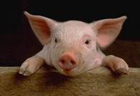

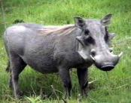
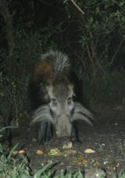
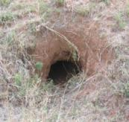
Epidemiology
Clinical disease_domestic pigs (Pig-pig cycle)
Wild boars (Europe) and the Caucasus
Sylvatic cycle- Warthogs, soft ticks (Ornithodoros moubata).
Other wild suidae-bush pigs, giant forest hogs.
Notes:
Få sjukdomar hos djur är så fruktade världen över som den afrikanska svinpesten.
I sin ursprungliga form är den en höggradigt smittsam, septikemisk viros som uteslutande drabbar svin. Sjukdomen beskrevs första gången 1921 som en perakut till akut förlöpande sjukdom, karakteriserad av blödningar och en mortalitet nära 100 %.
Virulence of isolates varies from high (100% mortality in 7-10 days after exposure) to low virulence (only seroconversion occurs). ASF affects domestic pigs and wild pigs, including the warthog, bush pig, and giant forest hog in Africa and the feral pig in Europe.
Sjukdomen är mycket viktig som differentialdiagnos till klassisk svinpest, eftersom man inte kliniskt kan skilja dem åt.

Slide 4


Objectives:
Main Objective:
Provide information on epidemiology of ASF in Uganda & factors for its persistence.
Specific objectives:
(1) Investigate the dynamics of transmission of ASF in domestic pig production systems.
(2) Investigate the risk factors for ASF along the domestic pig value chain.
(3) Assess the role of wildlife (wild pigs and soft-ticks) in transmission of ASF.
(4) Assessment of genetic variability of ASF virus isolated from different hosts and places.

Slide 5
Objective 1: Investigating dynamics of transmission of ASF in domestic pig production systems.
Study area: Masaka and Rakai
Questionnaire survey and blood/serum samples from pigs
Findings
Risk factors; Feeding swill & getting replacement stock from other farms
High incidence rate (14.1/100pig farm years)
No evidence of long-term domestic pig carriers.

Slide 6
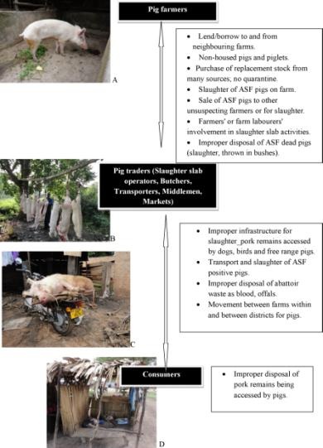
Objective 2: Investigate the risk factors for ASF along the domestic pig value chain.
Study area; Soroti, Tororo, Kabarole, Mityana, Mukono
Study population; Pig farmers and pig traders (middlemen, butchers, roast pork restaurants)
Findings;
Existence of potential risk factors
Poor infrastructure and ASF control/prevention mechanisms at district level.

Slide 7
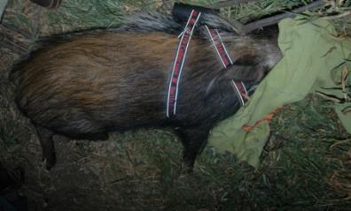

Objective 3: Assess the role of wildlife (wild pigs and soft-ticks) in transmission of ASF.
Bush pigs work
ELISA for antibodies against soft tick Ornithodoros moubata in sera of domestic and wild pig.

Slide 8
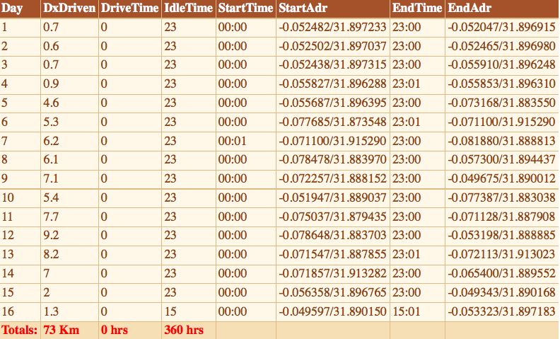
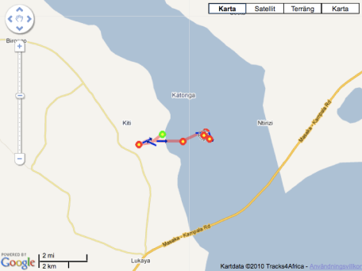
Unit sends GPS positions through GSM every 3 hours, and movements can be monitored online
Possible bush pigs-domestic pigs contact??
Notes:
A sero-survey of ASF in Kamuli and Kaliro districts, based on the screening of historical serum samples
A study on ASF based on abattoir sampling. The pork abattoir in Kampala receives pigs from all (or most) districts of the country. This makes it a suitable and convenient target for nation-wide disease surveillance. In addition the study will test the suitability of abattoir sampling as an early-warning instrument.
A longitudinal study of ASF in domestic pigs in selected districts. This study will give valuable information on the dynamics and impact of ASF in the selected districts, as well as information on which factors (e.g. herd, management, and spatial factors) affect disease prevalence and outcome. Farmer awareness will also be studied. In this component we also intend to follow the dynamics of individual outbreaks through repetitive sampling.
A study on the evolution of ASFV in a limited and isolated geographical area. In the Victoria Lake, two of the larger islands of Mukono district, Koome and Buvuma, harbour populations of domestic pigs interfacing populations of wild pigs (warthogs and bush pigs) which have been isolated from the mainland for years, and yet ASF is reported to be present in them. This study is expected to give novel insights into the dynamics of the disease and into the evolution of the virus under the very specific circumstances that prevail on these islands.
ASF in wildlife. This component will focus on ASF in warthogs, bush pigs and ticks and will depend on very close cooperation with the Uganda Wildlife Authority. Sampling of wildlife is costly and demanding, and this component of the study might therefore be excluded, depending on availability of funds and time after the half-time review of the project

Slide 9
Tick antibodies analysis
Employs recombinant protein TSGP1, a salivary gland protein (Diaz-Martin et al, 2011).
Results on inactivated sera at IRNASA, Spain (92 out of 500 samples or 18.4% from pig farms, slaughter slabs, outbreak samples, and wild pigs).
High exposure to the soft tick vector.

Slide 10
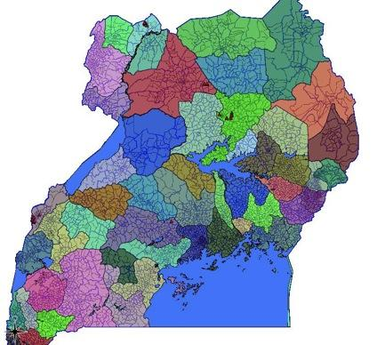
Objective 4: Assessment of genetic variability of ASF virus isolated from different hosts and places.
Bundibugyo-May
Moyo- June
Lira- Aug
Gulu- Aug, Oct, Nov, Dec, Jan
Mityana- Oct, Jan, June
Mpigi- Nov
Soroti- Dec
Kalangala- Jan
Kampala, Wakiso- Jan, July
Kyanamukaka-Feb
Bukakata- Feb
Masindi –March
Busia- March

Slide 11
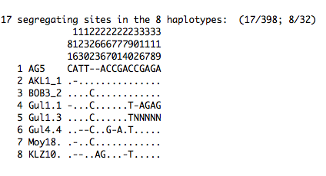
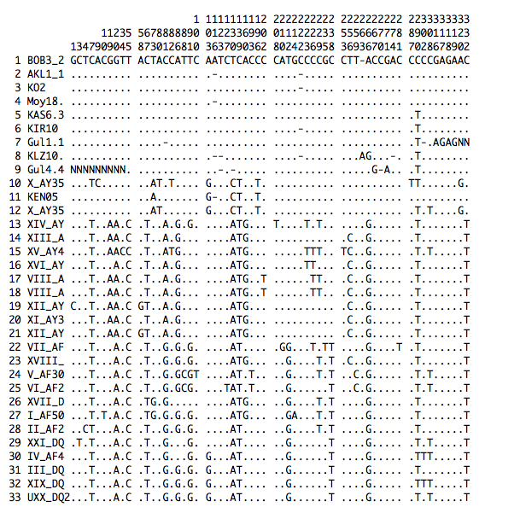
Fewer differences among UgASF across time and space
More differences btn Ug and the rest

Slide 12

Acknowledgements
Supervisors;
Makerere; Prof. OCAIDO Michael (Ph.D) SLU/SVA; Dr. STAHL Karl (Ph.D)
Dr. MASEMBE Charles (Ph.D) Prof. BERG Mikael (Ph.D)

