Slide 1
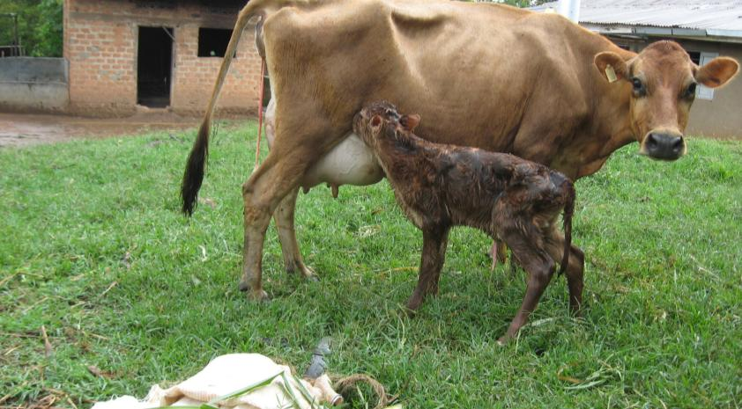



INFLUENCE OF REPRODUCTIVE AND UDDER HEALTH MANAGEMENT ON PERFORMANCE OF DAIRY COWS IN URBAN & PERI-URBAN KAMPALA AND GULU, UGANDA
Benon M. Kanyima

Slide 2
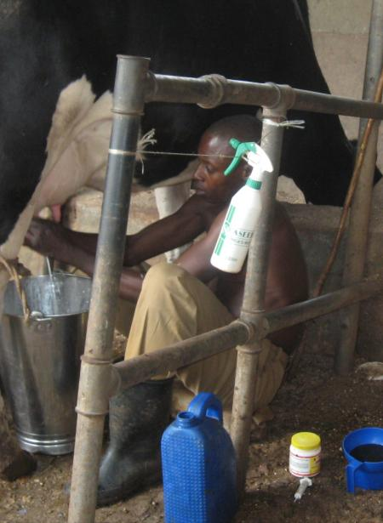

Background
Dairy cattle farming activity is engaged in by livestock keepers around many urban centers; Kampala city and Gulu municipality being some of them.
Dairy farming systems around urban areas are zero or open grazing on smallholder basis; dairy market and easy access to inputs are major attractions to this engagement.
Good cow reproduction and udder health are factors for productivity towards economic gains from farming are and are hallmarks of good dairy management

Slide 3
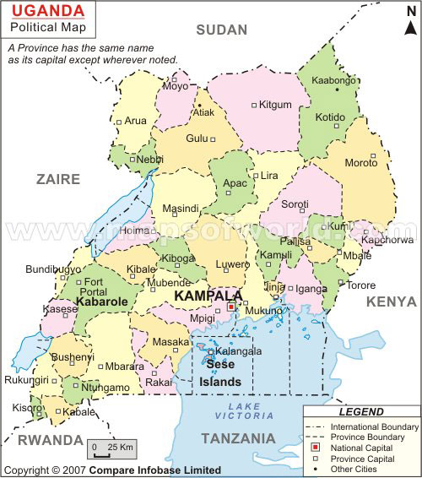

Slide 4
Study reports indicate that poor management practices (Musisa et al. 1999) poor cow reproduction (Nakiganda , 2006) and mastitis (Kivaria et al. 2004, Byarugaba et al. 2008, Almaw et al. 2009) prevalent among urban and peri-urban dairy farms were responsible for low milk production.
To understand the causes of poor dairy cow performance in urban and peri-urban herds , husbandry practices among dairy farming systems and the associated risk factors, require to be established.

Slide 5
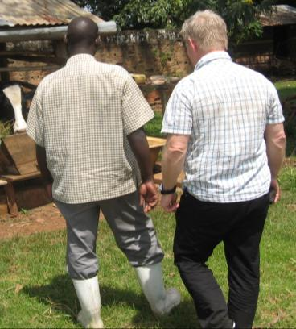
General research objective:
To establish prevalence rates of reproductive disorders, udder ill health and calf mortalities affecting dairy cow performance and provide models for cost effective mitigation measures for dairy farming in the urban & peri-urban livelihoods of Kampala and Gulu in Uganda.
Specific objectives:
To establish prevalence rates of reproductive disorders, udder ill-health, neonatal calf mortality.
To understand/determine the factors and practices associated with the prevalent rates of (a) reproductive disorders, (b) udder ill-health and (c) neonatal calf mortality among various dairy production systems

Slide 6
3.To provide model estimates for prevalent poor herd performance and its future improvement.
Study design
Cross-sectional study: - data collected by a structured questionnaire.
Physical examination to assess cow reproductive and quarter- health status , Californian Mastitis Test (CMT) and /or Delaval somatic cell counter protocols.
Longitudinal studies: - Resumption of post-partum ovarian activity
Data collected on cows (parities 1-6) on select farms in the Kampala urban/ peri-urban area, visited at 10-12 day intervals for a period of 5-6months

Slide 7
Findings
Resumption of pp ovarian activity in urban and peri-urban dairy cows
81.4% of cows resume ovarian activity by 60 pp in Kla.
Cow husbandry e.g. poor feeding & reproductive ill-health associated with malpractices e.g. mgt of RAB affect continuity of activity in 70.8% majority.
29.2% of cows continue cycles normally.
Subclinical mastitis.
Prevalence is high & affects quality of milk in majority of dairy farms. BMSCC on farms is >2x EU standard
Milk quality on 23.5% of farms is quite good (SCC level <400,000 cells comparable to EU standards).
Bacterial resistance to penicillin in clinical mastitis is an emerging problem; due probably to misuse of antibiotics.

Slide 10
Policy Recommendations
A format to support post-strife rural –urban immigrants engaging in urban and peri-urban dairy farming for their socio-economic well-being. E.g Accessing critical services as “public good.” Dairy production would contribute to farmers incomes and ensure food security in this livelihood.
Develop differential price rewards for quality milk production to encourage farmers attend to hygienic milk production and control of antibiotic residues in milk – good for both dairy cows and human welfare.
Establish a Dairy cow welfare policy to ensure cow reproductive and udder health as well as housing to facilitate the cows’ production potential.

Slide 11
Progress
Paper I: Husbandry factors influencing the resumption of ovarian activity in dairy cows under open and zero-grazing farming system in urban and peri-urban Kampala. (under final review for submission)
Paper II: Effects of husbandry practices/farming systems on reproductive performance of dairy cows in peri-urban farms in Gulu and Kampala (In Preparation)
Paper III: Factors affecting milk production, quality and yield of dairy cows in peri-urban farms in Gulu & Kampala, Uganda (In Preparation)
Paper IV: Model estimates for abortion, calving & neonatal calf mortality rates affecting cow reproductive performance in urban and peri-urban dairy farming systems of Gulu and Kampala (Not yet started)

Slide 12
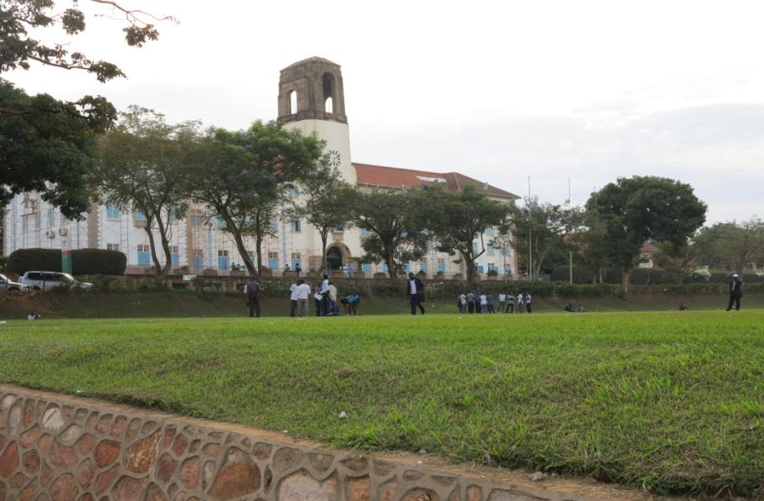
Acknowledgements;
1. Sida-Makerere bilateral cooperation program
2. PhD Supervisors@
SLU
COVAB
Thank you
“

