Slide 1


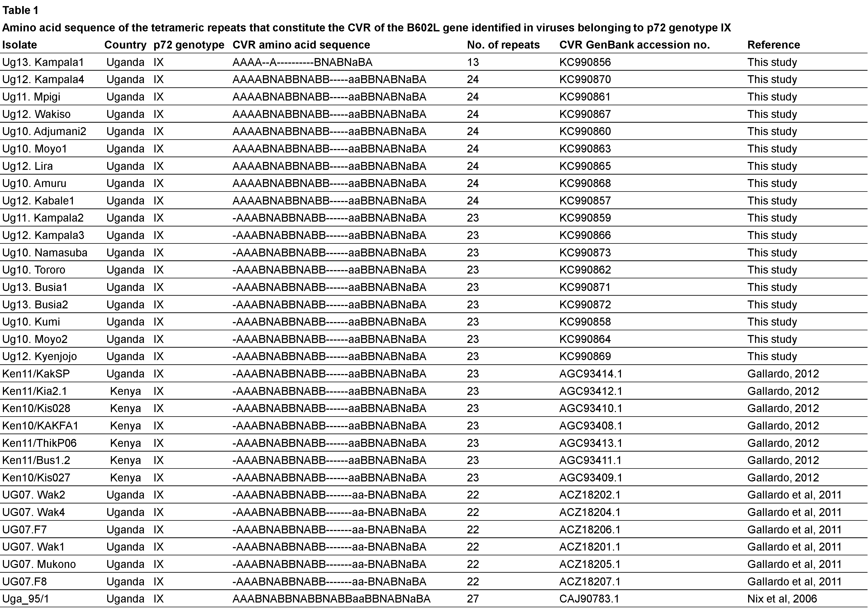
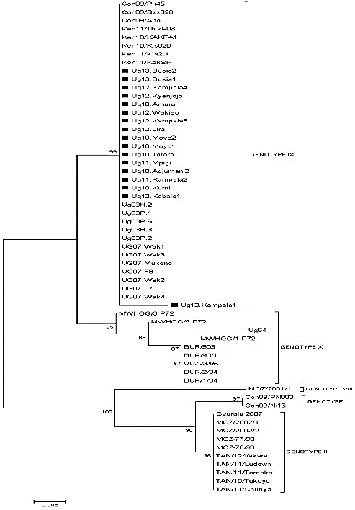
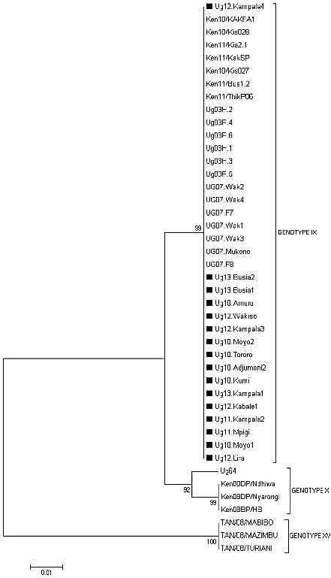
Molecular characterization and phylogenetic study of African swine fever virus isolates from recent outbreaks in Uganda (2010–2013)
David Kalenzi Atuhaire^{1,2}, Mathias Afayoa¹, Sylvester Ochwo¹, Savannah Mwesigwa¹, Julius Boniface Okuni¹, William Olaho-Mukani³ and Lonzy Ojok¹
¹College of Veterinary Medicine, Animal resources and Biosecurity, Makerere University,
²National Agricultural Research Organization, National Livestock Resources Research Institute,
³African Union-Interafrican Bureau of Animal Resources, P.O. BOX 30786, Nairobi, Kenya
Introduction
Results
African swine fever (ASF) is a highly lethal and economically significant disease of domestic pigs in Eastern Africa particularly in Uganda where outbreaks regularly occur. Sequence analysis of variable genome regions have been extensively used for molecular epidemiological studies of African swine fever virus (ASFV) isolates. By combining p72, P54 and pB602L (CVR), a high level resolution approach is achieved for viral discrimination.
Twenty one ASF outbreaks were confirmed by the p72 ASF diagnostic PCR, however; only 17 isolates were successfully aligned after sequencing. Our entire isolates cluster with previous ASF viruses in genotype IX isolated in Uganda and Kenya using p72 and P54 genes. Analysis of the CVR gene generated three sub-groups one with 23 tetrameric amino acid repeats (TRS) with an additional CAST sequence, the second with 22 TRS while one isolate Ug13. Kampala1 had 13 TRS.
Objectives
Key: A, CAST; a, CVST; B, CADT, CADI; N, NVDT. Dashes indicate gaps introduced manually to enable similarities between sequences to be easily visible. The number following the name of the virus isolate indicates the isolation year.
The major aim of this study was to investigate the genetic relatedness of ASF outbreaks that occurred between 2010 and 2013 in Uganda to contribute to the clarification of the epidemiological situation over a four year period.
Conclusion
We identified two new CVR subgroups different from previous studies. This study constitutes the first detailed assessment of the molecular epidemiology of ASFV in domestic pigs in the different regions of Uganda.
Methods
Tissue samples from infected domestic pigs associated with an ASF outbreak from 15 districts in Uganda were confirmed as being infected with ASFV using a p72 gene-based polymerase chain reaction amplification (PCR) assay recommended by OIE. The analysis was conducted by genotyping based on sequence data from three single copy ASFV genes. The E183L gene encoding the structural protein P54 and part of the gene encoding the p72 protein was used to delineate genotypes. Intra-genotypic resolution of viral relationships was achieved by analysis of tetramer amino acid repeats within the hypervariable CVR of the B602L gene.
References
Figure 1. Evolutionary relationships of p72 genotypes: neighbor-joining tree of the p72 gene. The analysis involved 59 nucleotide sequences. The p72 sequences from this study are marked with ■.
Figure 2. Evolutionary relationships of P54 genotypes: the neighbor-joining tree of the P54 gene. The analysis involved 43 nucleotide sequences. The P54 sequences from this study are marked with ■.
Gallardo C: Characterization of 2010 and 2011 African swine fever outbreaks in Kenya. 2012.
Gallardo C, Ademun AR, Nieto R, Nantima N, Arias M, Pelayo V, Bishop RP: Genotyping of African swine fever virus (ASFV) isolates associated with disease outbreaks in Uganda in 2007. Afr J Biotechnol 2011. 10:3488-3497
Nix RJ, Gallardo C, Hutchings G, Blanco E, Dixon LK: Molecular epidemiology of African swine fever virus studied by analysis of four variable genome regions. Arch Virol 2006, 151:2475-2494
This study was funded by the Millennium Science Initiative under the Uganda National Council of Science and Technology

