Slide 1
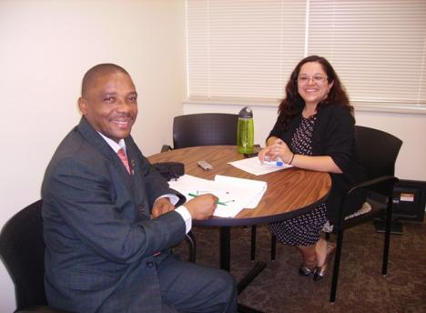
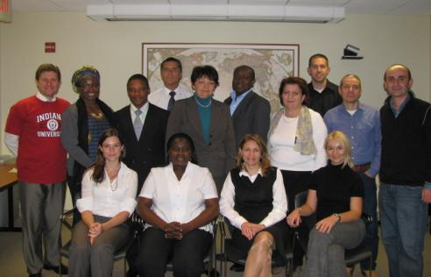
University Administration Support Program
Supported by the Carnegie Corporation of New York

Slide 2
(International Research & Exchanges Board) IREX
IREX is an international nonprofit organization providing thought leadership and innovative programs to promote positive lasting change globally. We enable local individuals and institutions to build key elements of a vibrant society:
  quality education
  independent media
  strong communities

Slide 3
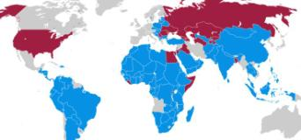
IREX
Founded 1968
Annual portfolio of over
$60 million
Field offices in 27 countries
Over 40 years experience administering
research support programs in Eastern Europe and Eurasia
Activities in more than 100 countries
More than 500 staff worldwide

Slide 4
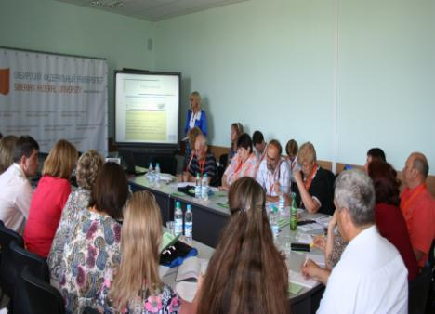
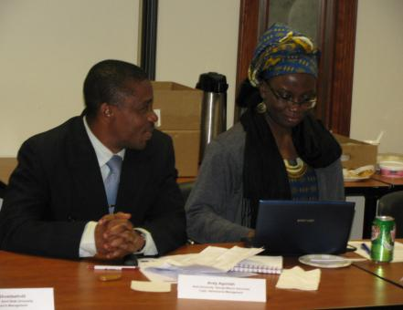
EDUCATION
Education supports economic development, social reform, and civic participation within a society and provides the foundation for tomorrow’s leaders.
IREX designs programs and provides consulting to support lifelong learning starting at the primary and secondary levels, continuing through higher education, and including professional training.

Slide 5
Benefits to Working with IREX
IREX has relationships with over 500 universities and colleges, and uses a customized approach to place researchers at host universities and research centers that support their academic and professional goals.
IREX fosters professional development through training on topics such as:
  Leadership skills
  Higher education management
  Career development
Participants can increase their professional and international networks through collaboration with other program participants.

Slide 6
University Administration Support Program (UASP)
Designed by IREX
Supported by the Carnegie Corporation of New York
Established in 2001
Provides short-term training for mid and senior-level university administrators from Eurasia and Africa to spend approximately 8 weeks with counterparts at respected U.S. public universities to work on specific reform projects to strengthen university management capacity.

Slide 7
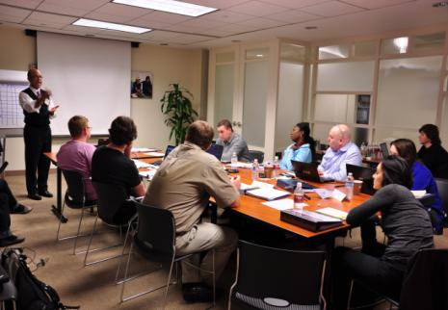
UASP also:
Supports international universities in implementing administrative and management reforms
Builds and develops partnerships between international and US universities
Encourages knowledge transfer to reach a wider community of universities and managers
Supports university managers’ integration into the global education reform community

Slide 8
UASP Impact
Over 107 senior university administrators completed an 8-10 week management training program at a US public university
Over 30 UASP alumni and their institutions received funding for small grants to jump-start reform projects at their home universities
More than 300 peer-to-peer management trainings for Eurasian colleagues have been developed

Slide 9
UASP is open to administrators at eligible universities who:
Are able to converse independently in English in order to work in the United States and engage colleagues;
Are committed to management reform and writing a case study on a topic of university administration while in the United States;
Hold a full-time position with the title of Vice-Rector, Vice-Chancellor, Dean, Vice-Dean, Department Chair, or working in an equivalent management position focusing on higher education reform in the Ministry of Education.
The list of eligible universities is provided in the in the Application Instructions

Slide 10
UASP Management Topics
Admissions Management
Alumni Relations
Campus Life/Student Services
Community Relations
Corporate Relations
Fundraising/Development
Government Relations
Academic Department Management
Human Resources Management
International Relations
Research Management
Strategic Planning
Tech Transfer
University Financing
University Governance/Trustees

Slide 11
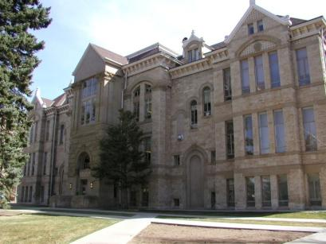
US Host Institutions
Participants are affiliated with administrative departments of US public universities appropriate to their selected management interest
Participants are matched with a mentor who will introduce them to the system of administration at US universities

Slide 12
UASP Provides
J-1 visa support for the period of the program
Round-trip travel from fellows’ home cities to the US host institutions
Accident and sickness insurance
Housing and $40/day daily allowance for meals and incidentals
Professional development allowance of $1000 for educational materials, professional conferences and membership in US professional associations
Leadership and management training workshop in Washington, DC at the start of the program
Two-day case study presentation workshop in Washington, DC at the conclusion of the program

Slide 13
UASP Case Studies and
Pilot Project Grants
Participants author short articles or case studies, presenting models for university management change based on their experiences in the United States
Based on the results of their case study, interested participants create a proposal for a Pilot Project Grant to support targeted institutional change at their home university

Slide 14
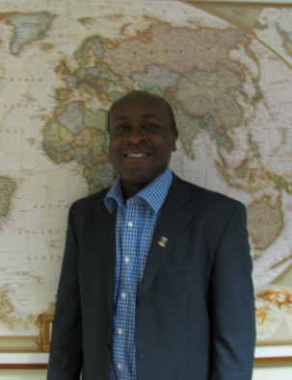
UASP Alumni Activity
Kweku Osam has recently accepted the position of Pro-Vice Chancellor of Academic Affairs at the University of Ghana. In addition to his responsibilities overseeing the university’s academic activities, he has also prioritized faculty development and training activities, which he focused on during his UASP fellowship at the University of Central Florida.

Slide 15
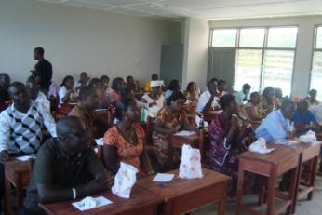
UASP Alumni Activity
Through a Pilot Project Grant, Felicia Takrama created a administrative reform project to increase the involvement of alumni of the University of Education, Winneba in local and district chapters of the Alumni Association. The project is reaching out to alumni to create at least 30 district chapters to provide training and networking opportunities for alumni.

Slide 16
UASP Timeline
May 1, 2012: Application deadline
June 2012: Semi-finalists interviews and Finalist notification
Mid September – Mid November 2012: Cohort I Fellowship in the United States
Late January – Late March 2013: Cohort II Fellowship in the United States

Slide 17
UASP Selection Criteria
(in order of importance)
Appropriateness of the applicant's position within the university to influence management practices in the selected topic.
Relevance of the selected managerial topic to the university's or ministry’s priorities.
Prior management experience of the applicant.
Thoroughness and relevance of applicants answers to application questions.
Ability to converse independently in English.

Slide 18
A Complete Application
Must Include:
A completed Application Form
Curriculum Vitae (CV)
Letter of Support from the Rector of your Home Institution
Organization Chart of your Home Institution’s Administrative Structure
Each of these items must meet the criteria outlined in the Application Instructions.

Slide 19
UASP Application Deadline
is Tuesday, May 1, 2012 at 5 PM
(Washington, DC time)
An electronic copy of the application along with all of the supporting documentation must be emailed to uasp@irex.org
Incomplete applications will not be considered.

Slide 20
Questions?
May be addressed to IREX staff at uasp@irex.org
Application Deadline:
5 PM, May 1, 2012
(Washington, DC time)

